Slide 1
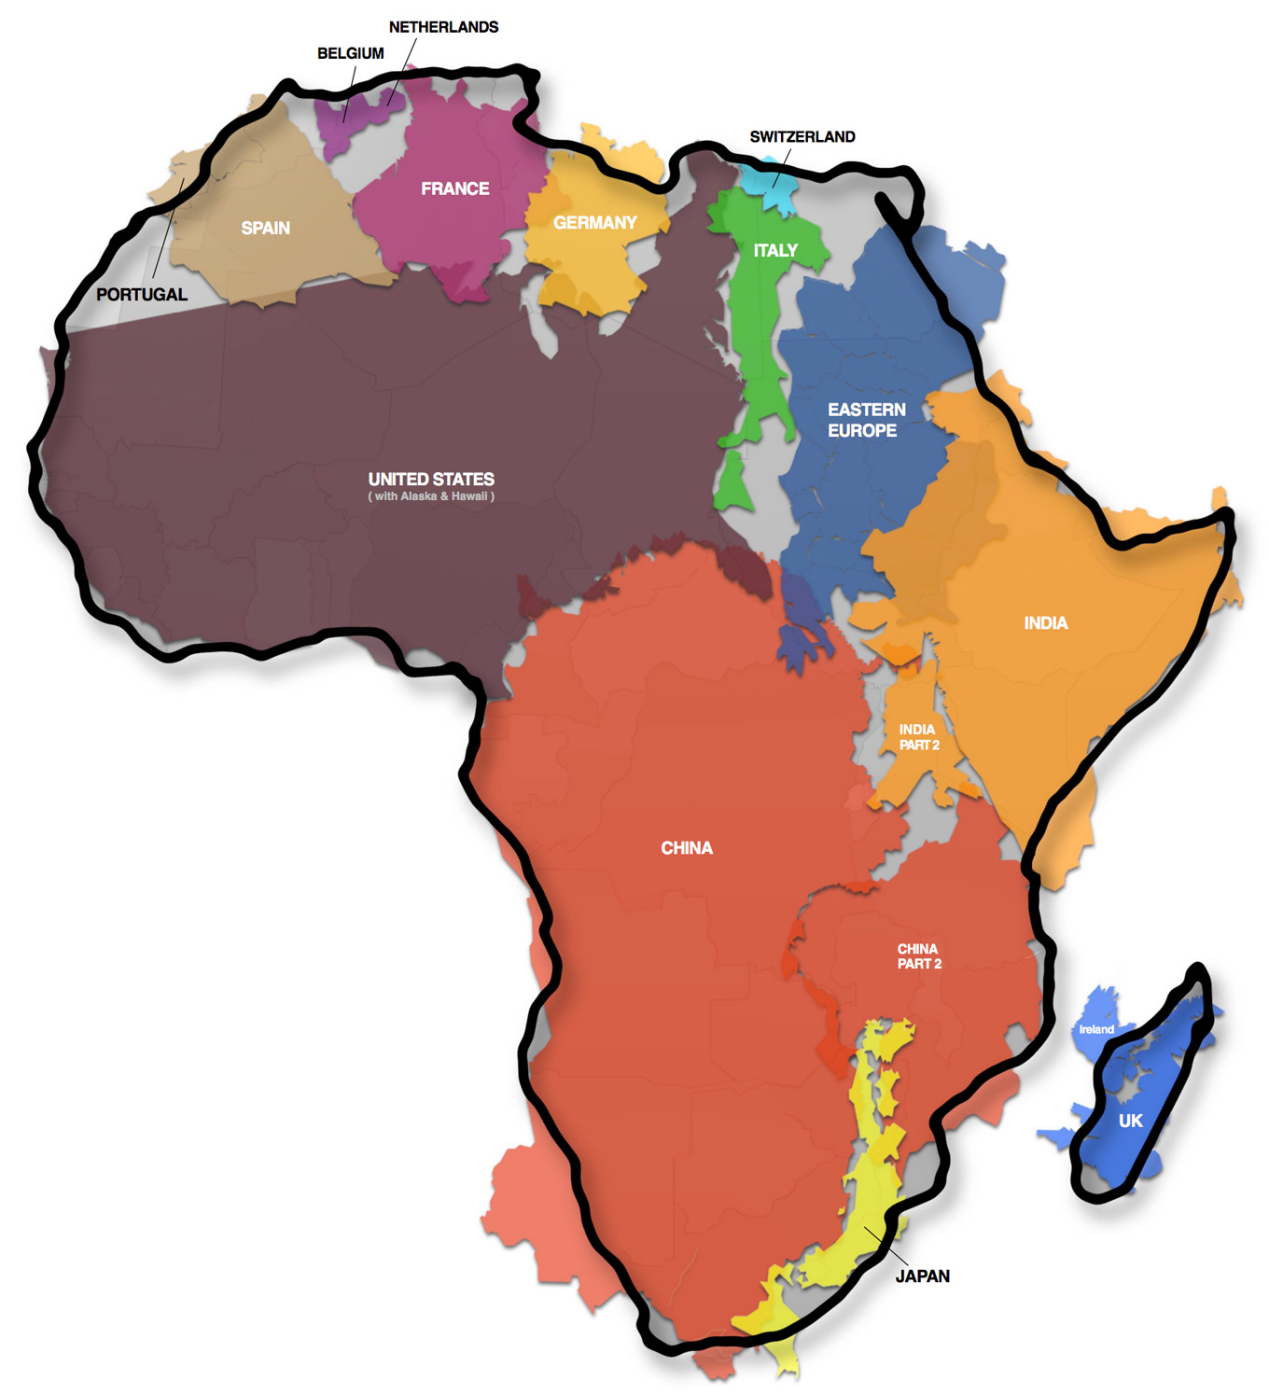
The actual size of Africa…
Why Africa’s size might be a good thing | Why Africa’s size might be a bad thing
Claims to larger pieces of land means a bigger area to expand the nation There might be more riches Gold Silver Ivory Slaves/Slave labor There will be more raw materials to send back to western Europe and manufacture into industrial goods | Claims on bigger pieces of land means... Countries have to give up more soldiers to defend territory More money spent on army Many ethnic groups in Africa may cause conflicts within territories
Notes:
http://thetruesize.com/#?borders=1~!MTYyMTcyOTY.MzY2NTE4Nw*MzU0NzE2NTA(MjAyMDQ3OA~!CONTIGUOUS_US*MTAwMjQwNzU.MjUwMjM1MTc(MTc1)MA~!IN*NTI2NDA1MQ.Nzg2MzQyMQ)MQ~!CN*OTkyMTY5Nw.NzMxNDcwNQ(MjI1)Mg

Slide 2
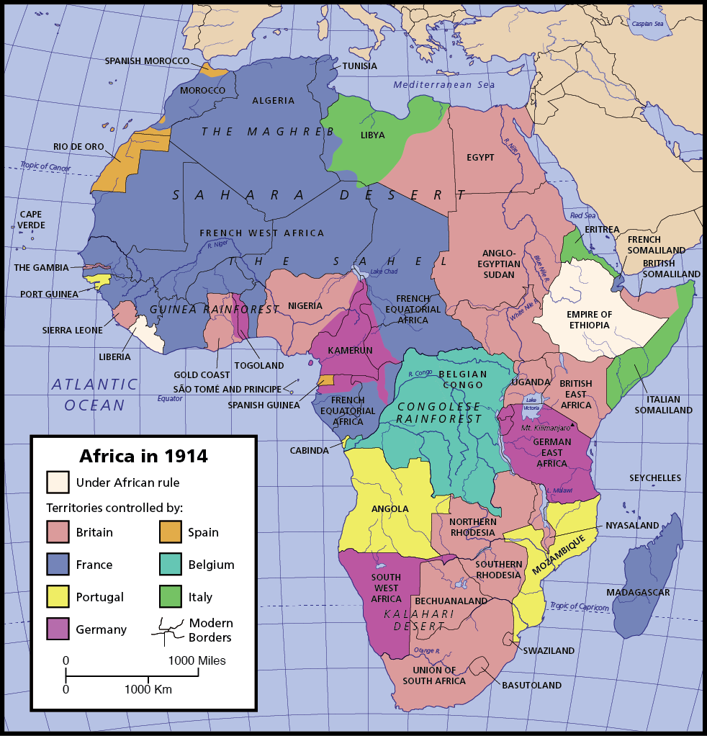
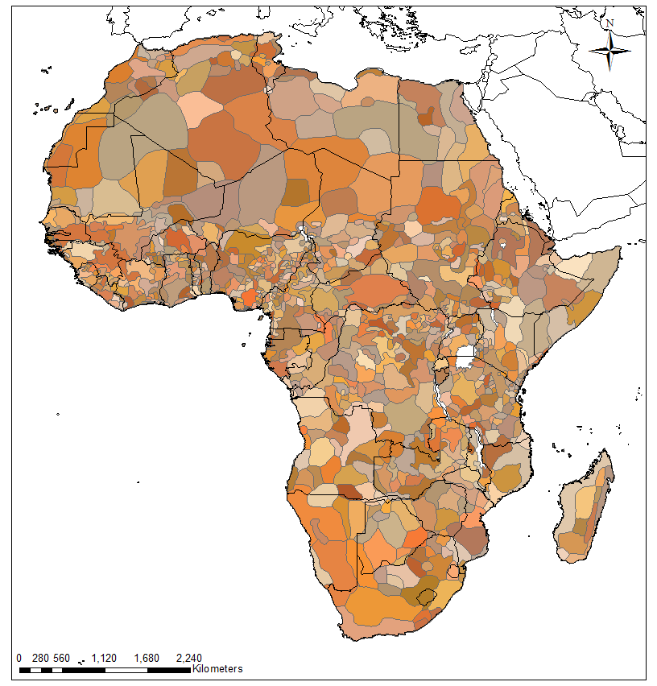
Conflict between ethnic division of African & colonial division of Africa.

Slide 3
Regional Resources in Africa (worksheet corrections): PGS 392-393
West Africa
Cultures:
-Many groups were united by the Muslim religion.
-An Islamic state was set up which increased literacy & trade, but decreased local wars.
-Powerful Asante kingdom (not an Islamic state) ruled several small groups of people (states)
Conflicts:
-The spread of the Muslim religion (and Islamic law) caused tribes to rise up against European rulers.
-Small states under the Asante rule wanted change and to revolt against powerful rule
Resources:
-Forested areas.
-Slave trade already exists between ethnic groups
Northern Africa
Cultures:
-People of the region were united by the Muslim religion and were part of the Ottoman Empire at the beginning of the decade. (Ottoman empire influence would significantly decline by the 1880’s).
Conflicts: N/A
Resources:
-No resources mentioned. The landscape of northern Africa is made up of the Sahara desert and very fertile (rich) soils of the Fertile Crescent.

Slide 4
Corrections continued…
East Africa
Cultures:
-Muslim values were important to the peoples (states)
-Trade with Europe and India was important to these empires.
Conflicts: N/A
Resources:
-Slaves (from the interior of Africa)
-Ivory
-Copper
Southern Africa
Cultures:
-Zulu kingdom
-Boer
-Many diverse cultural groups
Conflicts:
-The Zulu kingdom conquered many groups around them which led to mass-migration & wars throughout the region
-The migrating Boers (descendants of Dutch settlers) had very brutal conflicts with the Zulu
Resources:
-Land

Slide 5
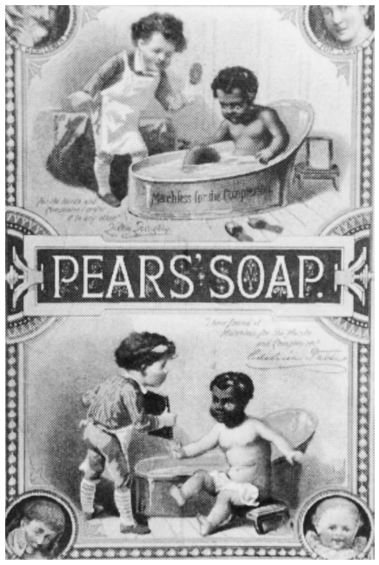
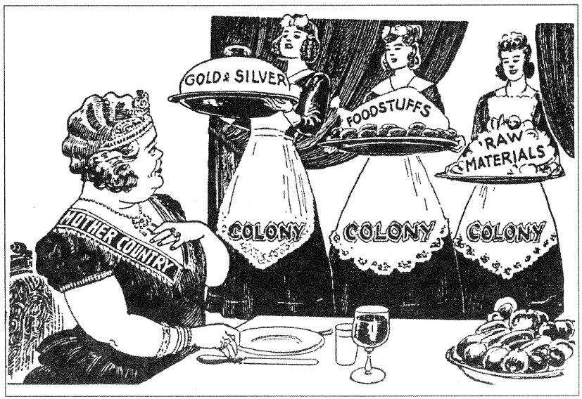
Social Darwinism is seen in advertising…

Slide 6
Complete the organizer as I draw it.....
Types of Colonial Rule
Indirect Rule
Direct Rule

Slide 7
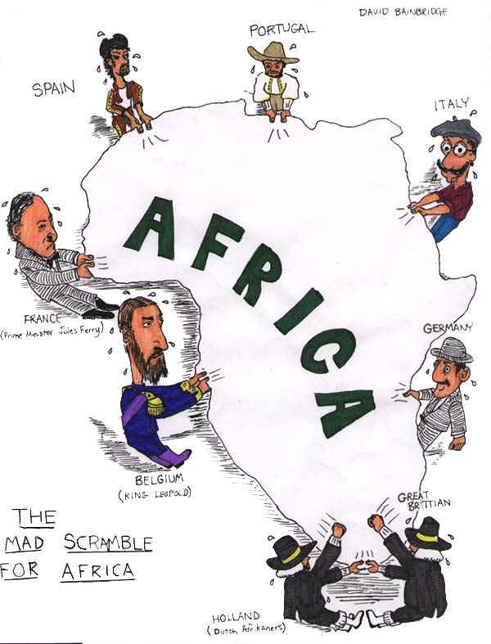
How Africa was divided… (Berlin Conference)

Slide 8
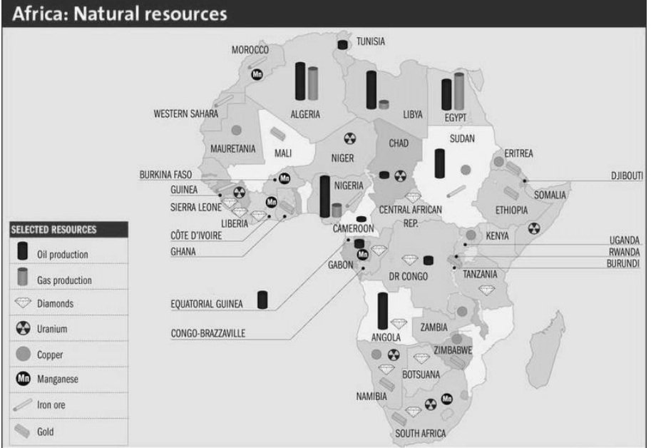
Berlin Conference
1884
Hosted by Otto Van Bismark
European leaders met in Berlin, Germany in order to avoid problems among each other.
No Africans invited
European powers agreed that in order to claim a territory, each country had to:
Establish an outpost in the territory.
Effectively defend territory

Slide 9
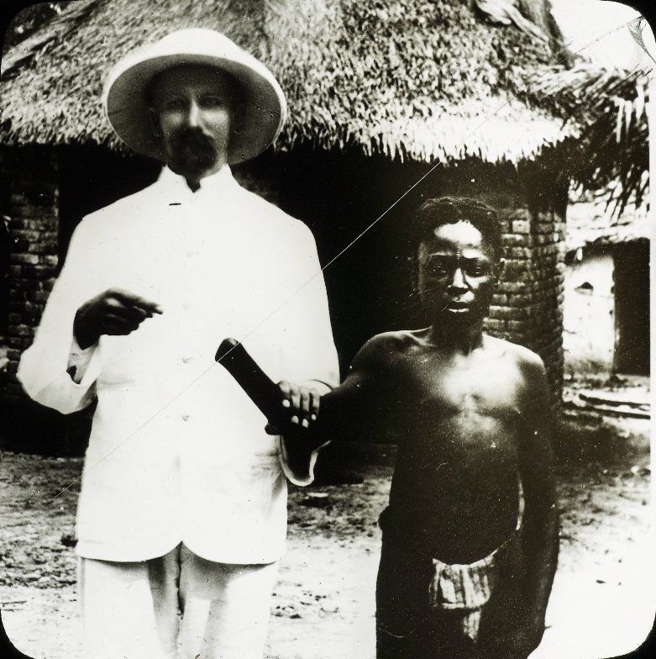
Colonial Conflicts in Africa

Slide 10
The Congo: one of the most brutal Euro-African relationships

Slide 11
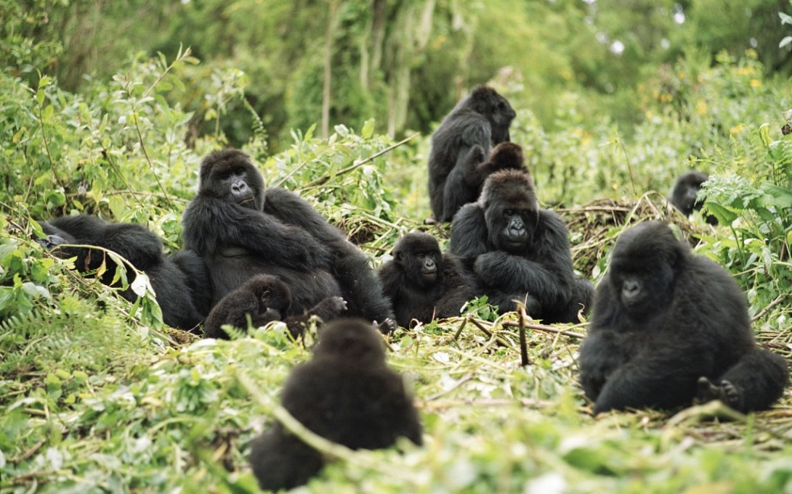
Congo: Before Imperialism
Location:
Central Africa
Climate:
Rain forest & Plateau
Resources:
Iron
Copper
Rubber Trees
People (often traded people for ivory)

Slide 12
Congo: Imperial motives
Completely economic
The most valuable good was rubber for gloves, shoes, & soap
Claimed & conquered by King Leopold II (Belgium)

Slide 13
Congo: Life in the colony
Brutal: African people were completely enslaved
Government:
Direct rule
Called the “Force Publique”
King Leopold established quota (certain amount) of rubber that he expected to be collected
The “Force Publique” was ordered to publicly beat, mutilate, or kill Africans who did not meet the quota

Slide 15
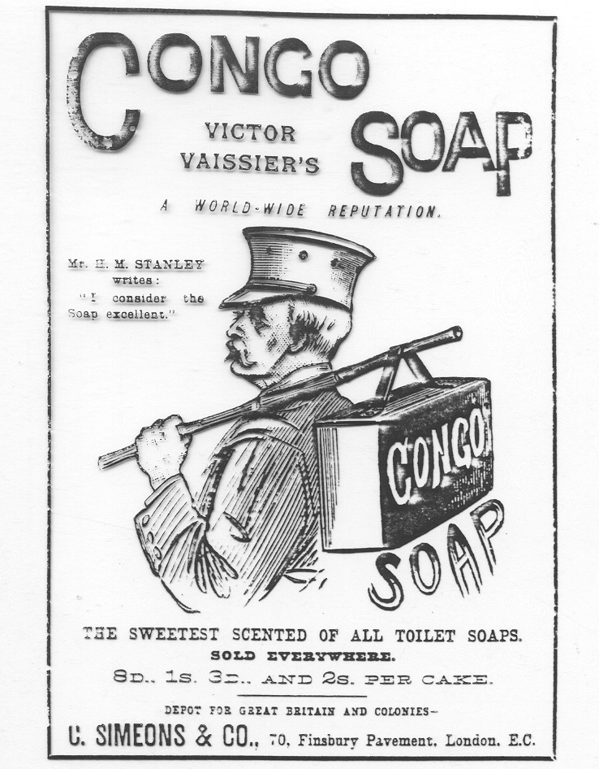
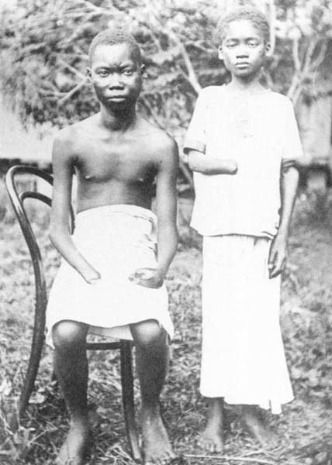
Population of the Congo declined from 20 million to 8.5 million under Belgian control

Slide 16
How might colonialism have effected the development of Congo after Belgian Control?

Slide 17
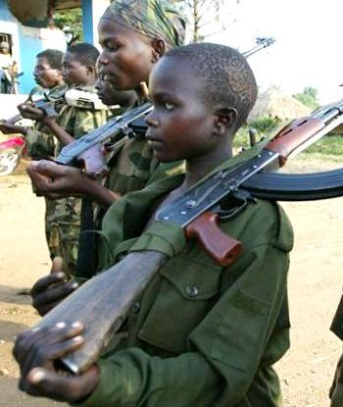
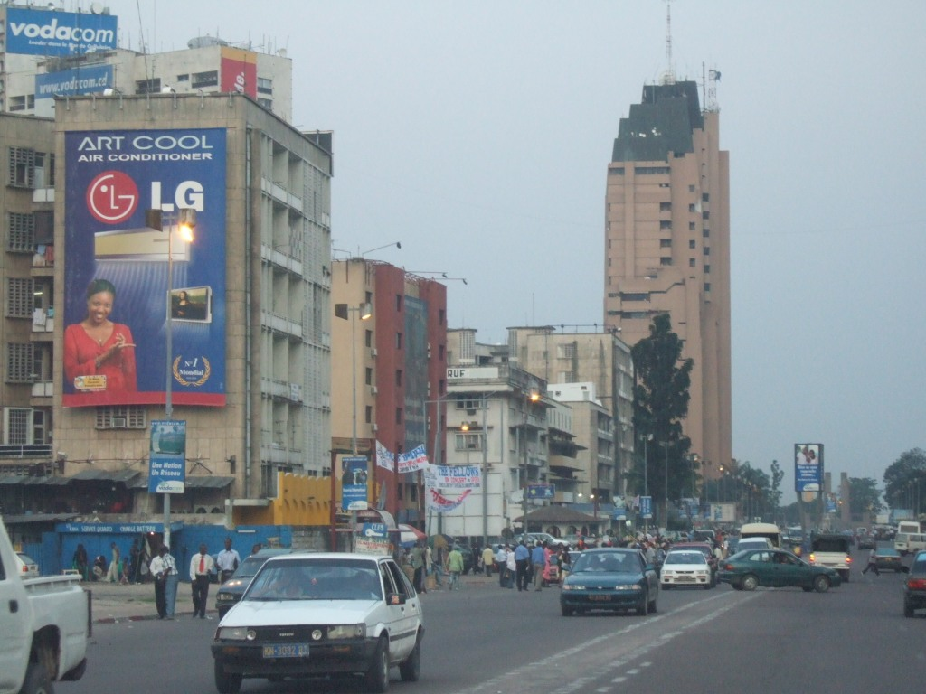
Today: Congo is one of the poorest countries in the world & is facing constant civil war
5 million killed(45,000 per month)
Millions of refugees & child soldiers
Rape used as a method of warfare (200,000 reported)

Slide 18
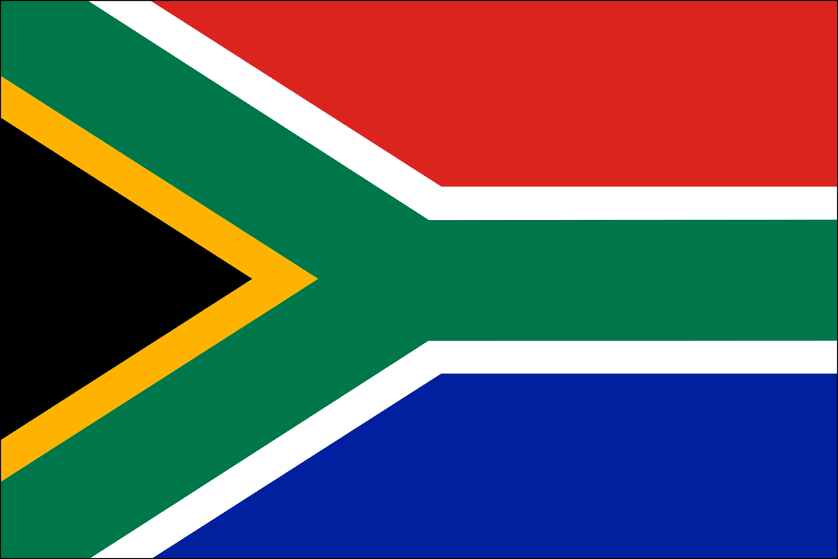
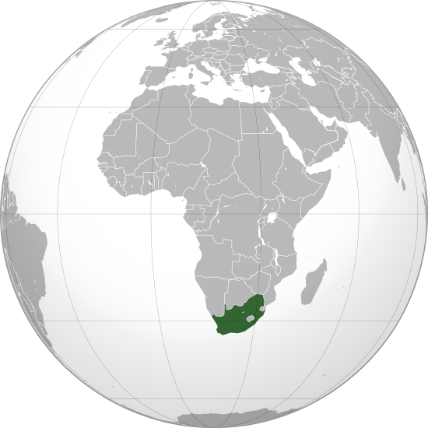
South Africa:

Slide 19
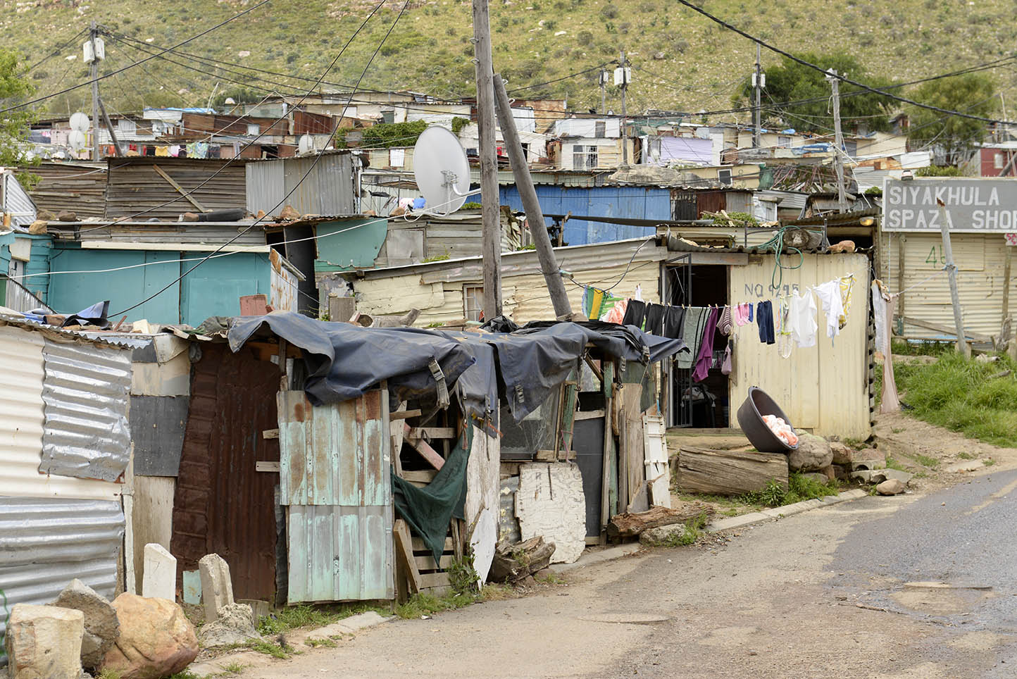
South Africa: Before Imperialism
Location:
South Africa
United by the Zulu tribe
The “Cape of Good Hope” was an important sea port to Europeans on their way to India
Resources:
Diamonds
Gold
Land (cape of good hope)

Slide 20
South Africa: Imperial Motives
Political:
Diamonds
Gold
Economic:
Great location to control trade to India

Slide 21
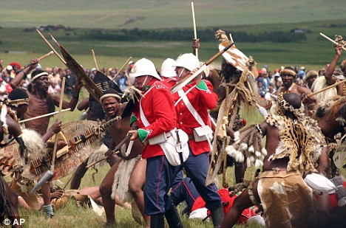
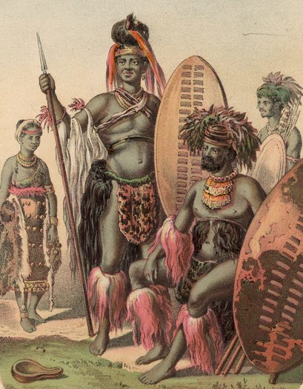
South Africa: Conflicts & Life
Conflicts:
Zulu VS. Boer (Dutch)
British VS. Zulu (United Africans)
Boer VS. Zulu
Zulu almost won both wars, even though they only had spears
Originally the British governed directly, but eventually a protectorate was established
Severe racial discrimination

Slide 22
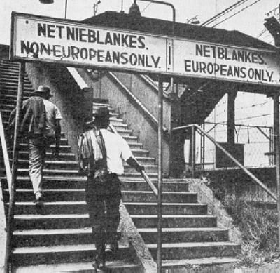
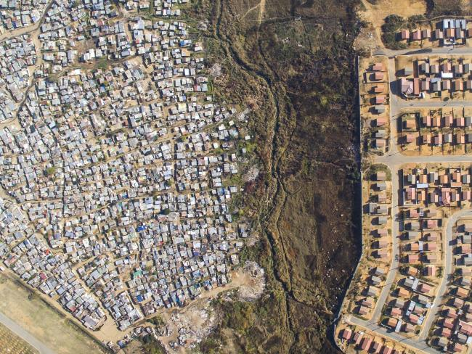
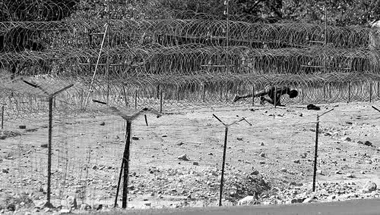
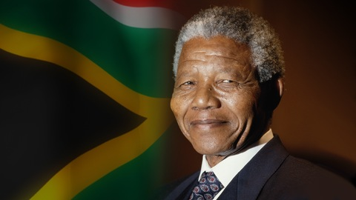
South Africa: Results of Colonial Rule
Racial Discrimination (1910 – 1948)
Laws restricting voting, housing, property, schooling, jobs…
Apartheid (1948 – 1994)
Segregation of whites, blacks and mixed people
Enforced by the law

Slide 23
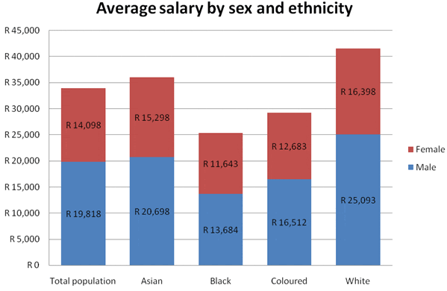

Slide 24
Ethiopia: A Nation that Resisted Imperialism
Read “Africans resist imperialism” on page #397 in your book.
Write 3 sentences that describe why/how Ethiopia resisted the colonial powers initially.

