Slide 1
Religion in India
Hinduism & Islam

Slide 2
Most Hindu’s today (and historically) live in India & Nepal
***
Choose one color to represent Hinduism, and color your map to show where Hindus live.

Slide 3
Origins:
India
 | Hinduism
People who practice this religion are called: | HINDU’S
Origin/ development of faith: | COMBINATION OF MANY INDIAN BELIEF SYSTEMS

Slide 4
Beliefs:
 | Hinduism
Most important beliefs: | REINCARNATION (Being born again in order to get another chance to achieve “Moksha”)
Goal in life: | TO ACHIEVE “MOKSHA” (total bliss & awareness)
Can be reincarnated at a higher or lower level of life depending on their karma from their present life.
Can be reborn as plants or animals (below humans) or to a higher caste in human society.
Death is not final for Hindus- they expect to be reborn many times.

Slide 5
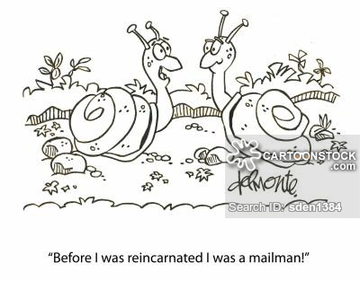

Slide 6
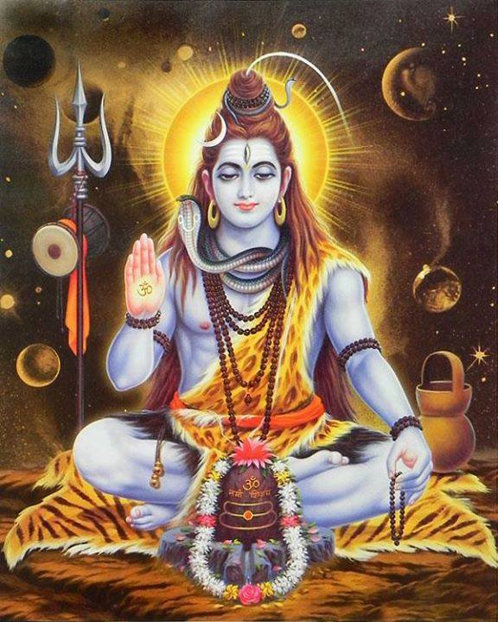
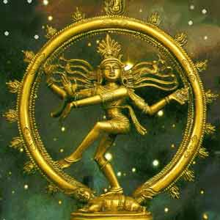
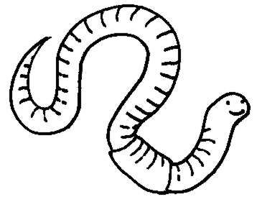
Life
Rebirth
Birth
Death (& Moksha)

Slide 7
Hindu Caste System:social class
Hindu society is divided into 4 social classes, called “Castes”.
BEFORE the British rule, there was little movement between castes, but movement could occur in extreme circumstances
DURING the British rule, there was NO social movement because established castes were used to:
Assign jobs/power to Indians
Take census’

Slide 8
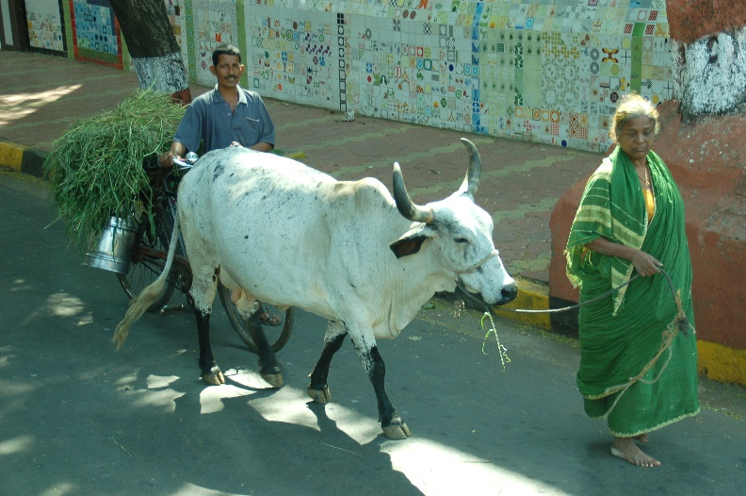
Unique Characteristics
Although it may seem that Hindu’s believe in many gods, they believe in one powerful god called “Brahman”.
All other gods are parts of the supreme god
All Hindu’s have 4 daily duties:
Respect the deities
Respect the ancestors
Respect all beings
Honor all humankind

Slide 9
Islam

Slide 10
Where in the world?
***
Use your second color to one color to represent Islam, and color your map to show where Muslims live.

Slide 11
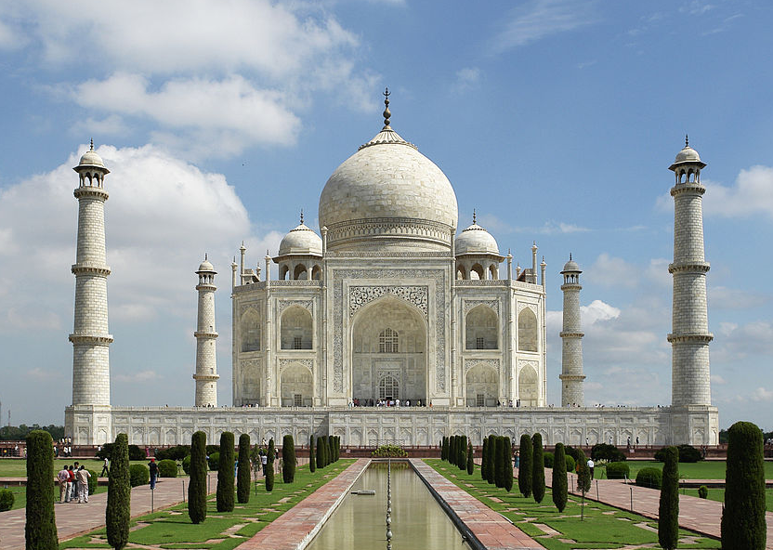
Legacy of The Empire of Islam
http://www.history.com/topics/taj-mahal/videos/deconstructing-history-taj-mahal
Islam is the second largest religion in the world, after Christianity, and the fastest growing.
Today there are over 1.7 million Muslims in the world.
Notes:
Taj Mahal built in memory of his favorite wife (of 3) who died in child labor, Shan Jahan Mahal built the building.

Slide 12
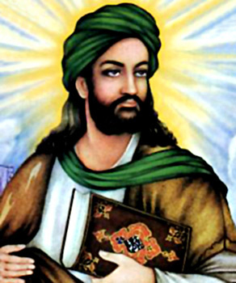
The Basics:
 | Hinduism | Islam
People who practice this religion are called: | X | MUSLIMS
Origin/development of faith: | X | ONE GOD - considered to be the same god as the Christian god. CENTRAL BOOK IS THE QURAN –written by Muhammad when the angel Gabriel revealed it.

Slide 13
The Basics:
 | Hinduism | Islam
Most important beliefs: | X | Belief in ALLAH- BELIEVERS ARE HIS “SERVANTS”. Unlike the Christian belief of god, ALLAH LOVES THOSE WHO ARE GOOD/FAITHFUL, BUT DOES NOT LOVE THOSE WHO ARE BAD.
Goal(s) of life: | X | TO GO TO HEAVEN- ALTHOUGH UNLIKE CHRISTIAN BELIEFS, YOU DO NOT GO STRAIGHT TO HEAVEN. Muslims believe that you stay in your grave until the last judgement day.

Slide 14
lets address some modern day stereotypes:

Slide 15
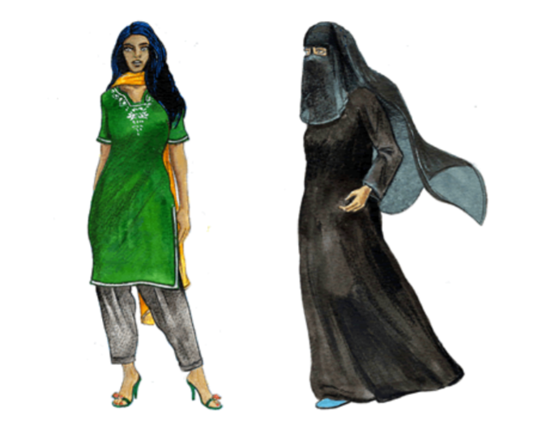
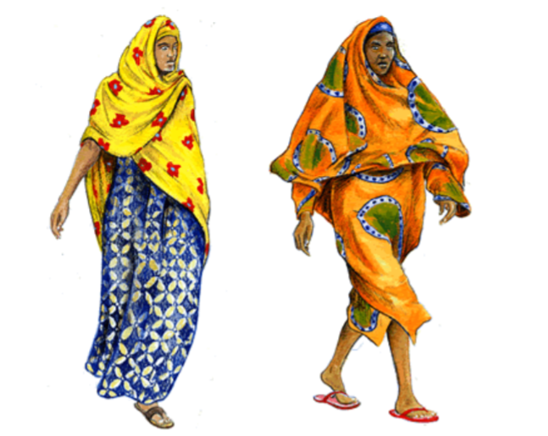
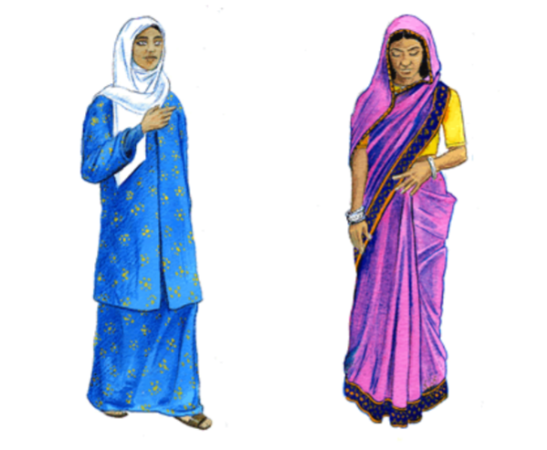
The Hijab & Burka
Pakistan & Saudi Arabia
Somali (East)& West Africa
Modesty (for men and women) is important to Islamic beliefs, but this looks different in many parts of the world.
Malaysia & India/Bangladesh

Slide 16
Why do you think there was tension between the Hindus & Muslims in India before British Colonization?
**Put the items below into the Venn diagram to help you answer the questions above.
Caste system
Equality among men
Focus on self-realization
Focus on pleasing God
Reincarnation
One life
Unified beliefs across religion
Sacred text Quran
Modesty
#1
* Use 1 color to circle 2 elements of either religion that you think caused the most tension between the groups.
*THEN write 3 sentences to justify your answer.
#2

Slide 17
Check yo’self:
Hinduism: Islam:
Equality among men
Focus on pleasing God
One life
Unified beliefs
Quran
Modesty
Caste System
Self-realization
Reincarnation

