Slide 1
WWII in the pacific

Slide 2
Write down everything you know about WWII in the Pacific.
Examples:
Who fought?
How/why did it start?
Describe the type of warfare.
When did it begin & end?
Where in the world did it happen?

Slide 3
Summary:
Fought by Japan & the Allied Powers
Impacted people of SE Asia (conquered by Japan) because much of the fighting occurred on their land
Began with Japanese expansion & the Sino-Japanese war in 1937
U.S. Became involved when Japan bombed Pearl Harbor
Fought using planes, ships, and “island hopping” invasions
Fighting occurred in Pacific Ocean (ended 1945)

Slide 4
Use a T-chart to compare the attitudes of the Japanese & the attitudes of the people whose land they occupied.
Japanese Propaganda Video:
https://www.youtube.com/watch?v=icVu-acHlpU
WWII in the Philippines Interview Video: https://www.youtube.com/watch?v=Lm2HSWRYVVQ

Slide 5
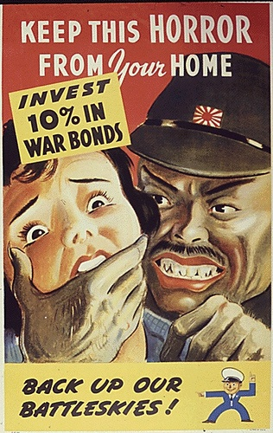
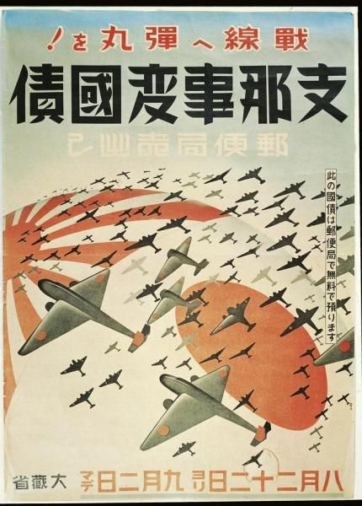
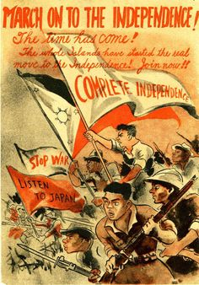
Create your own Propaganda Poster
Use what you learned today to make a Propaganda poster that shows the viewpoint of one group involved in WWII in the Pacific.

Slide 6
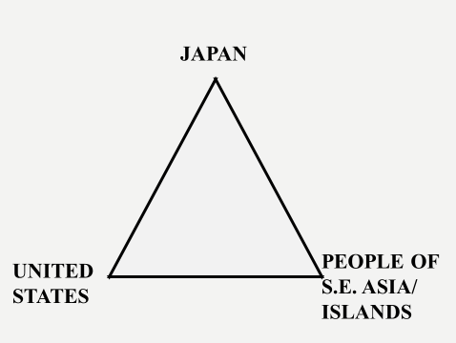
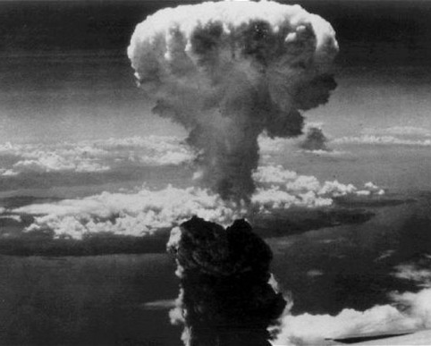
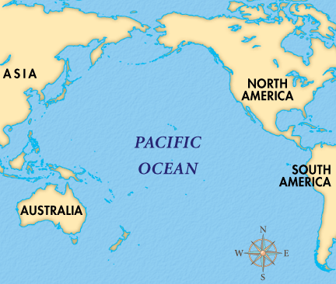
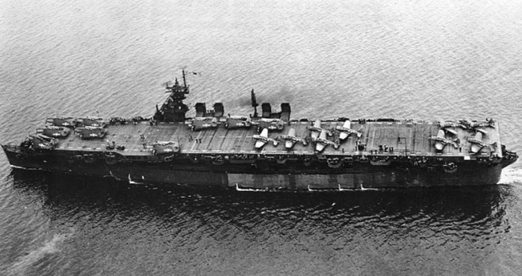
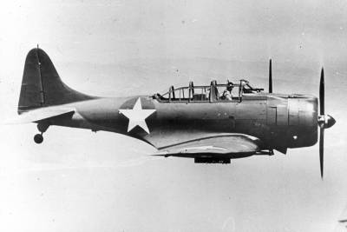
Quick Review:

