Slide 1
World Geography
Chapter 3
Population and Culture

Slide 2
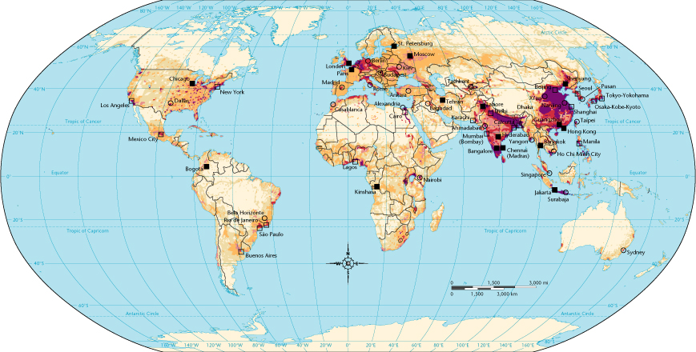
Where People Live
1
Western Europe
East Asia
Eastern U.S.
South Asia

Slide 3
Population Growth
1
Modern technology, such as improved medical care and increased food production, has enabled people to live much longer.
Different countries have different CBR’s (Crude Birth Rate) or the number of live births per 1,000 people per year.
Population is affected by the number of immigrants and emigrants.
Some demographers predict population growth will bring:
Positives: | Negatives:
Increased technology Increased creativity | Famine Disease Resource depletion

Slide 4
Elements of Culture
1
Food
Clothing
Religion
Language
Architecture
Government

Slide 5
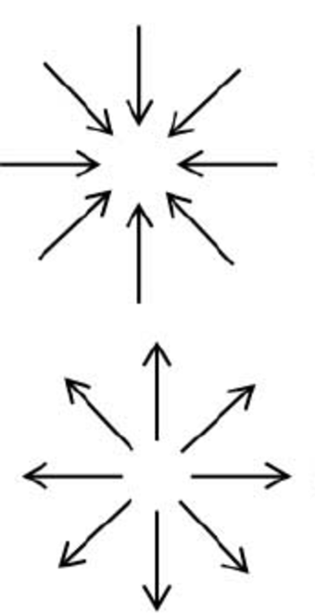
Cultural Change
1
Cultural convergence occurs when the skills, arts, ideas, habits, and institutions of one culture come into contact with those of another culture and combine to create something new.
Cultural divergence, occurs when cultural contact is limited or whole or partial cultures are separated and become something new.

Slide 6
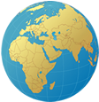
Political and Economic Systems
2
What are four characteristics shared by all countries?
How do types of government & economic systems differ from one another?

Slide 7
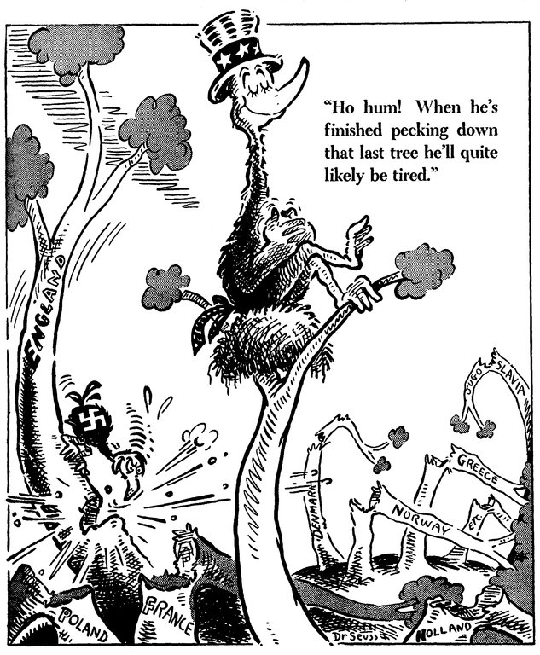
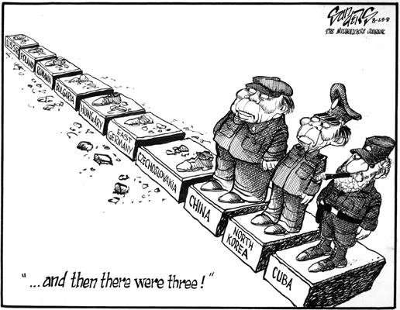

Slide 8
The World’s Countries
2
Each country has four specific characteristics
Sovereignty is a nation’s freedom from outside control. A sovereign country is one that determines its own policies and actions.
Defined Territory | Population | Sovereignty | Government

Slide 9
Types of Government
2
A unitary system is one in which the central government makes decisions for the entire country.
In a federation, the national government has some powers and others are reserved for local governments.
Smaller political units keep their sovereignty and give the central government few powers in a confederation.
U
F
C

Slide 10
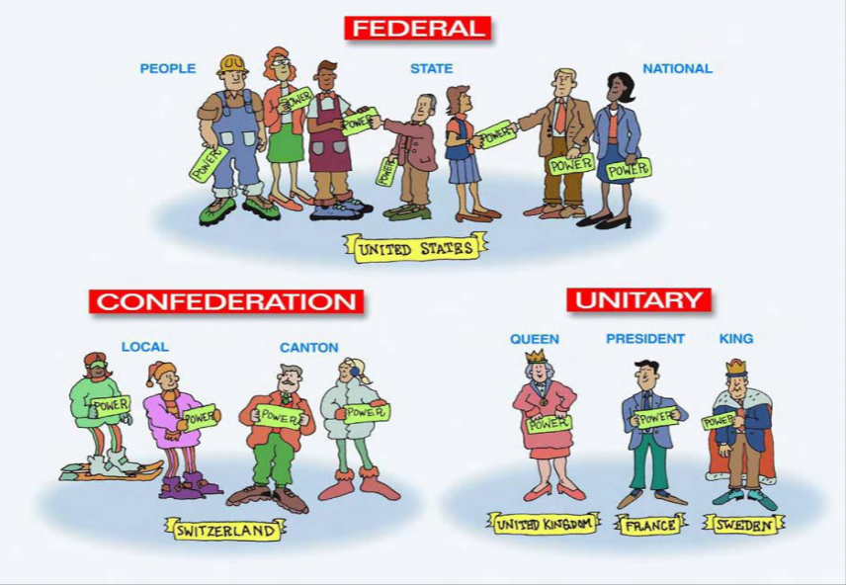
How is Power Shared?

Slide 12
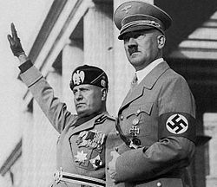
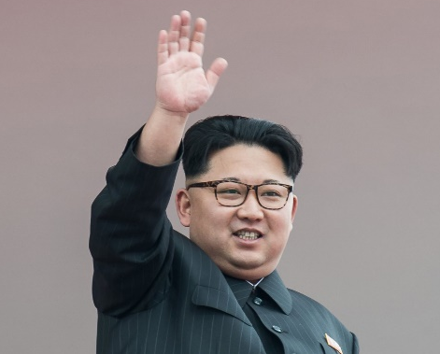
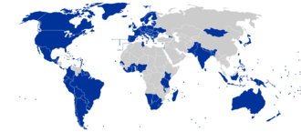
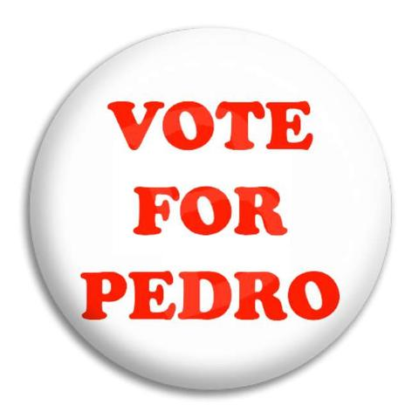
Government Authority
A dictatorship is a government in which power is concentrated in few people, and totalitarianism is the most extreme form of dictatorship.
Any country in which people choose their own leaders and set government policy is a democracy.

Slide 13
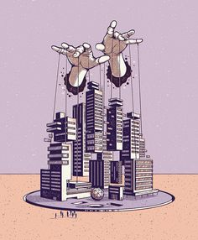
Types of Economic Systems
2
In a traditional economy, all goods and services produced by people are consumed by their own families or villages.
A market economy is an economy in which decisions/prices are influenced by the “laws of supply and demand.”
A command economy is an economic system that is controlled by a single, central government, and decisions are made to achieve political or social goals.

Slide 14
Section 2 Review
2
In a confederation, smaller political units
a) have little power, and the central government makes all the decisions.
b) have powers reserved to them that the central government does not have.
c) retain their sovereignty, while the central government is very limited.
d) do not exist at all.
Socialism is an example of a
a) traditional economy.
b) market economy.
c) command economy.
d) mixed economy.

Slide 15
Section 2 Review
2
In a confederation, smaller political units
a) have little power, and the central government makes all the decisions.
b) have powers reserved to them that the central government does not have.
c) retain their sovereignty, while the central government is very limited.
do not exist at all.
Socialism is an example of a
a) traditional economy.
b) market economy.
c) command economy.
d) mixed economy.

