Slide 1
Distribution of World Population
Population concentrations
The four largest population clusters
Other population clusters
Sparsely populated regions
Dry lands – Cold lands
Wet lands – High lands
Population density
Arithmetic density
Physiological density
Agricultural density

Slide 2
World Population Cartogram
This cartogram display countries by size of their population rather than
their land area. (Only countries with 50 million or more people are named.)

Slide 3
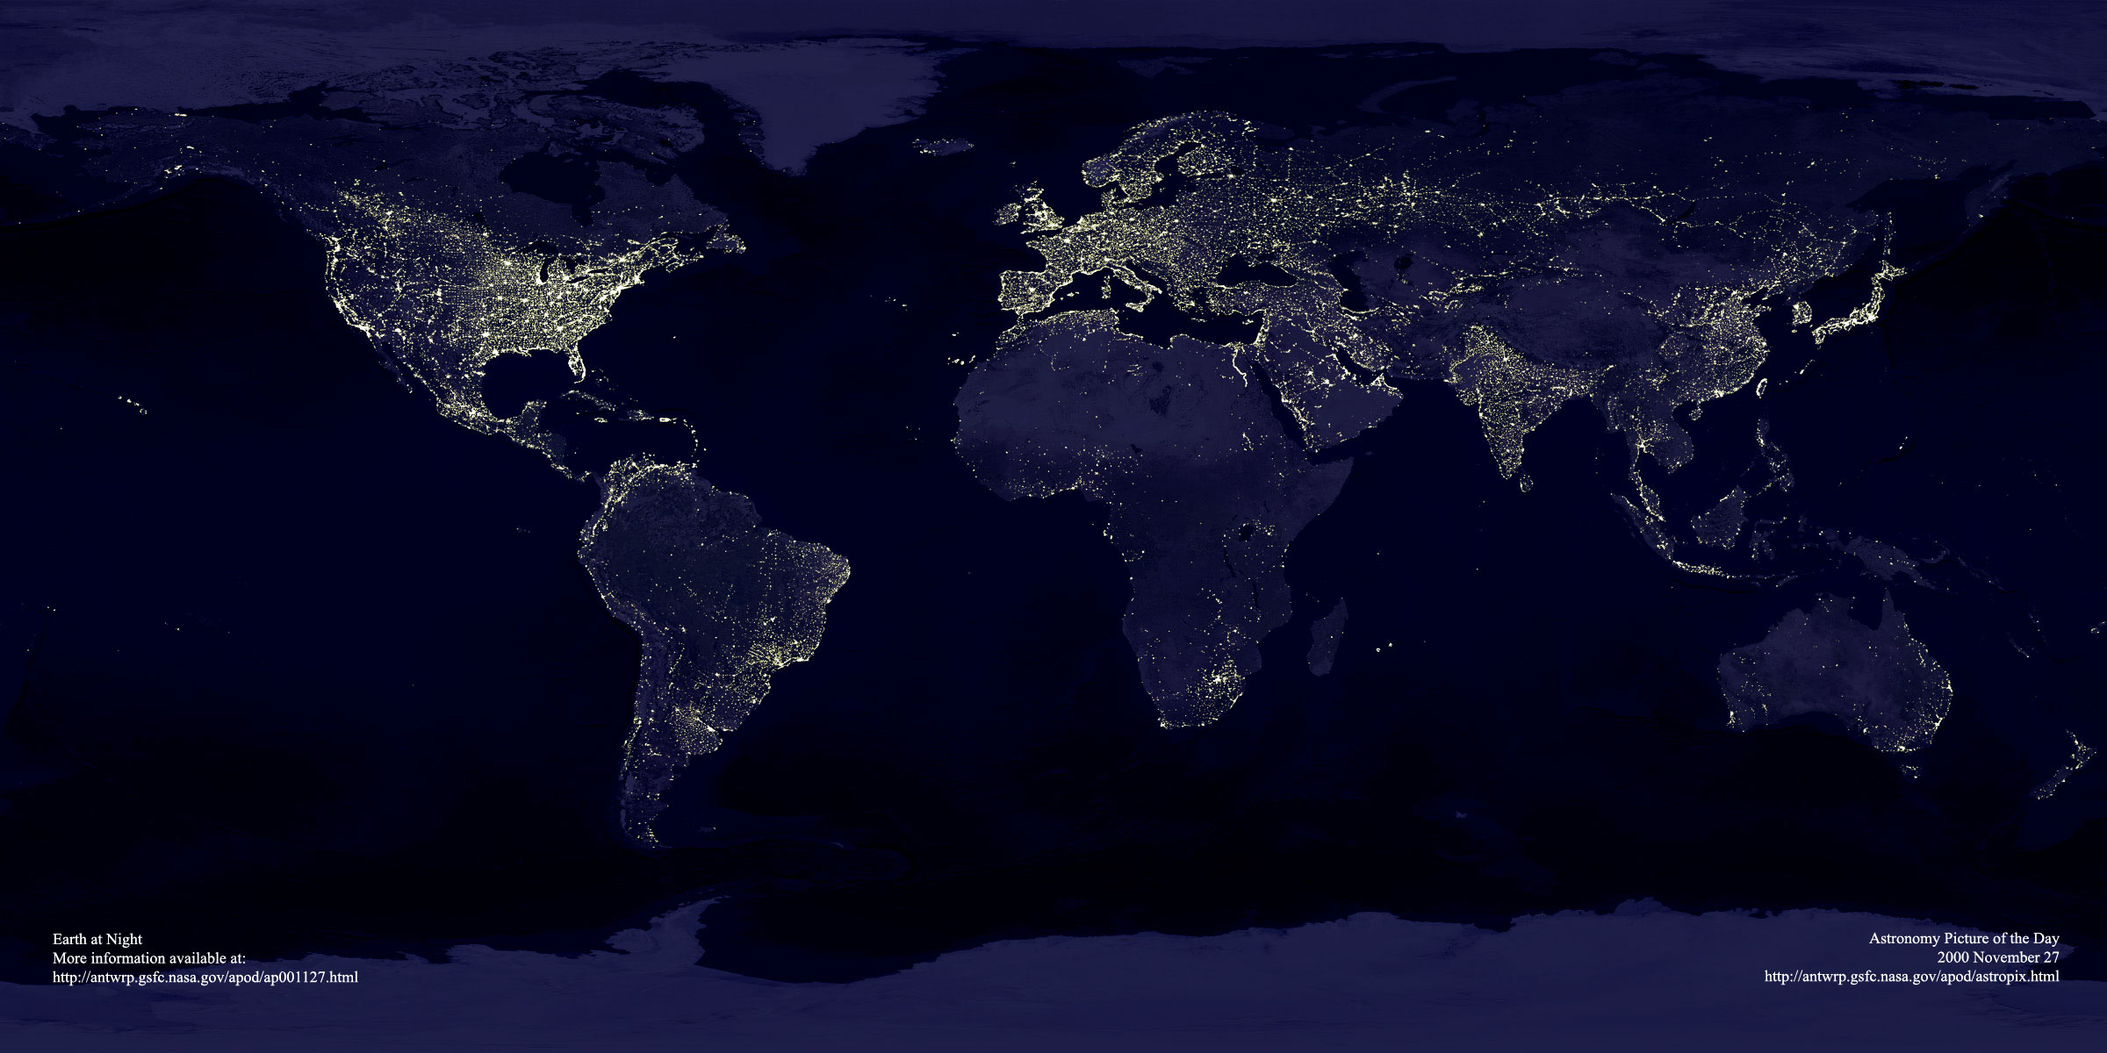
The Earth at Night… http://antwrp.gsfc.nasa.gov/apod/image/0011/earthlights2_dmsp_big.jpg

Slide 4
KEY 1: Pop distribution basically = concentration & density
Pop. Concentrations: 3/4 of people live on 5% of Earth's surface -----remember 71% of surf. = oceans, other areas are harsh
5 major concentr. = E. Asia, S. Asia, SE Asia, W. Europe, Eastern N. Amer.
similarities.: most near water, low-lying, fert. soil, temperate (warm, but not hot)

Slide 5
1) East Asia #1 in pop. (China, Koreas, Japan, Taiwan): 1/4 world pop. here
China: #1 in pop., #3 in land area; most on river valleys & coasts; 3/4 rural--most farmers
3/4 of Japan. & S. Kor. = urban
2) South Asia: #2 in pop.; (Pakistan, India, Bangladesh, Sri Lanka)
--3/4 of this pop. in India
-most on coast or along Indus & Ganges Rivers; 1/4 cities most of pop. = rural farmers

Slide 6
World Population Distribution
World population is very unevenly distributed across the Earth’s surface & it can be compared to climate distribution.

Slide 7
3) SE Asia: #4 pop.; (Islands: Java, Sumatra, Borneo, Pap. New Guinea, & Philippines, + Thailand, Vietnam, etc.)
-most are farmers in rural areas
In these 3 Asian areas = over 50% of world’s pop. on only 10% of world's land
4) Europe: #3 pop.; 75% in cities; less than 20% farmers (many of farmers in S & E Eur.)
Import most of food rather than produce
historically tied to industry > farming

Slide 8
Expansion of the Ecumene 5000 B.C.–A.D. 1900
The
ecumene, or
the portion of
The Earth w/
permanent
human
settlement,
has
expanded
to cover
most of the
world’s land
area.

Slide 9
C) Population density: look at it 3 ways… (Deja vu!!!)
1) arithmetic density (aka population density):
-# people per unit of land…
2) Physiological density: # people per unit of arable land: is a more meaningful measure b/c can show pressure on the land due to population
3) agricultural density: ratio farmers to arable land
--lower agr. density = higher technology;
-MDC's: usually lower agri. density, & LDC’s usually higher;
-in MDC’s, lots of land & few farmers means more pop. to work in factories, etc.

Slide 10
Arithmetic Population Density
Fig. 2-4: Arithmetic population density: # of ppl per total land area. Highest densities found in parts of Asia & Eur.

Slide 11
Physiological Density
Fig. 2-5: Physiological density is the number of people per arable land area. This is a good measure of the relation between population and agricultural resources in a society.

Slide 12
Distribution of World Population Growth
Natural Increase (NIR)
Fertility (TFR)
Mortality (IMR + MMR)

Slide 13
KEY 2: Where Has World's Pop. Increased?
Important terms: (NOTE: crude means "basic", i.e., not specified by age, etc)
a) crude birth rate (CBR): # live births per 1,000 per year:
CBR = 20 means for every 1000 in a place, were 20 births
b) crude death rate (CDR) # deaths in year per 1,000
c) natural increase rate (NIR): % by which a pop. grows in a year…change CBR & CDR to %'s…
---------------------------------------------------------------------------------------------------------------------------------------------------------------------------------------------------------------------------------------------------------------------------
To calculate NIR: CBR - CDR = _____?____
then divide by 1000 to get NIR
EX: CBR = 25 CDR = 10 25 – 10 = 15 NI per 1000
------------------------------------------------------------------------------------------------------------------------------------------------------------------------------------------
Divide 15 by 1000 to get a % so it = 1.5% is NIR
CBR = 40 CDR = 28 NIR = .012 = 1.2%

Slide 14
Natural Increase Rates
**NIR is negative in Europe …means pop. is declining if you don't count immigrants
**Remember! "N" = "natural")
(NIR) = % of growth or decline in the pop. of a country per year (not including net migration). Countries in Africa & SW Asia have highest current rates; Russia & some European countries have negative rates.

Slide 15
Crude Birth Rates (CBR)
The crude birth rate (CBR) is the total # of births in a country per 1,000 population per year. Lowest rates: in Europe.
Highest rates: Africa & several Asian countries.

Slide 16
Total Fertility Rates (TFR)
The Total fertility rate (TFR) is the # of children an avg. woman in a society will have thru her childbearing years. Lowest rates: Europe. Highest: Africa & parts of Middle East.

Slide 17
Infant Mortality Rates (IMR)
The infant mortality rate: # of infant deaths per 1,000 live births per year. Highest: found in some of the poorest countries of Africa & Asia.

Slide 18
-MDC's: lower CBR's, TFR's, & IMR's…but higher life expectancy
-LDC's: high CBR, TFR, & IMR, but low life expectancy

Slide 19
Avg. Life Expectancy at birth
Life expectancy at birth: Avg. # of years a newborn infant can expect to live. Highest: generally in the wealthiest countries. Lowest: in the poorest countries.

Slide 20
Crude Death Rates (CDR)
The crude death rate (CDR): total # of deaths in a country per 1,000 population per year. B/C wealthy countries are in a late stage of the demographic transition, they often have a higher CDR than poorer countries!!!!!

