Slide 1
America 1920-2929
The Roarin’ 20’s

Slide 3
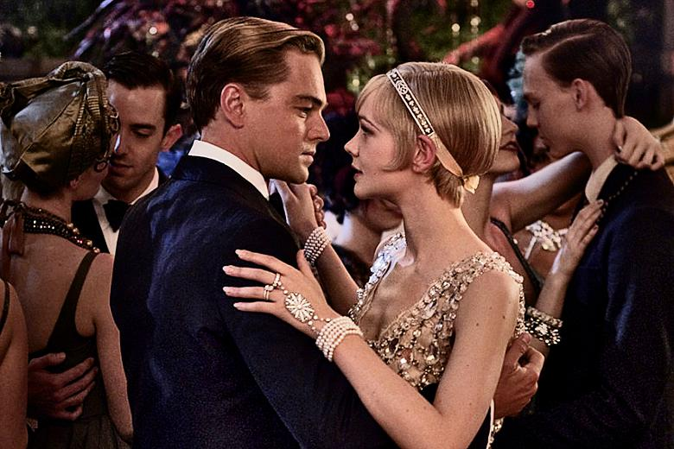
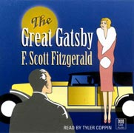

Slide 4
Economic Prosperity

Slide 5
Increased Nationalism

Slide 6
“Take a Walk” Instructions:
1. Use the worksheet in your folder titled “Social Changes in America”.
2. WALK around the room and look at the posters, each poster represents a term on the board
3. Use column 1 titled “Social Change” to GUESS which poster/picture matches each term
- Use the definitions on the board to help you
4. Use column 2 titled “Characteristics” to LIST the things you see on the poster.
- This will help you PREDICT what changes happened to American society during each movement

Slide 7
Consumer Culture
-Ford’s assembly line manufacturing style caused mass production and increased demand
-Invention of “buying on credit”
-Many new advancements in technology, including the radio, stoplight, and first single-person flight across the Atlantic ocean.

Slide 8
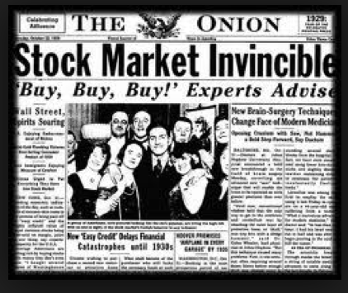
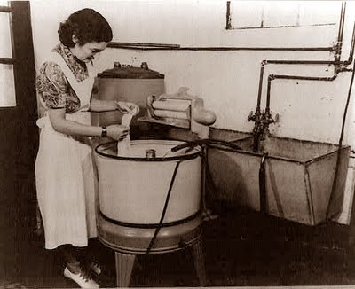
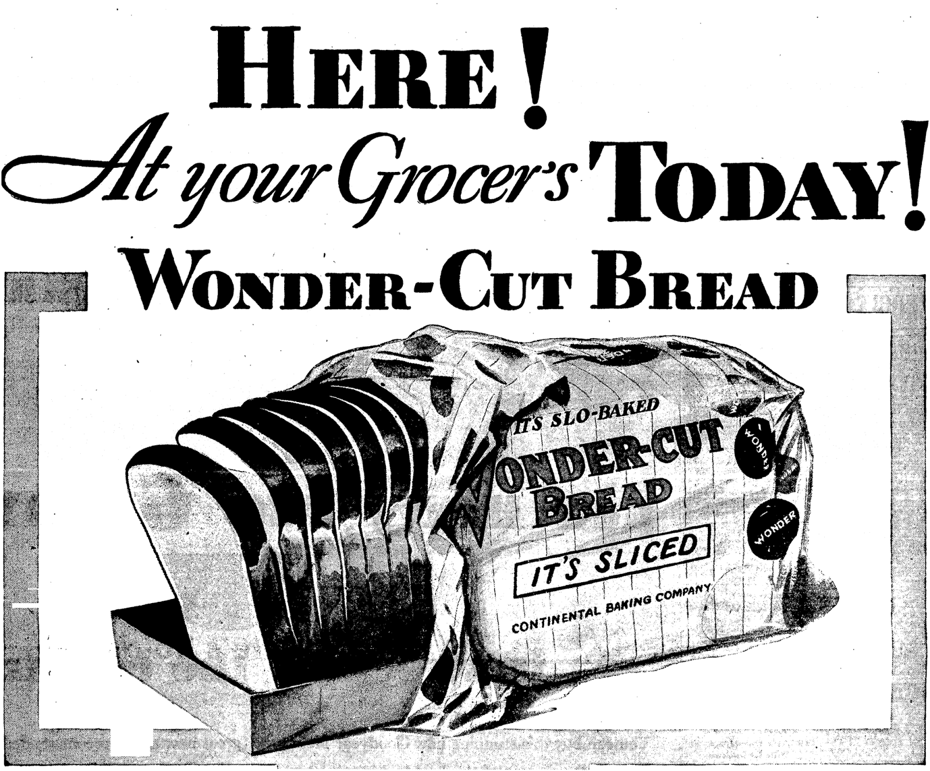
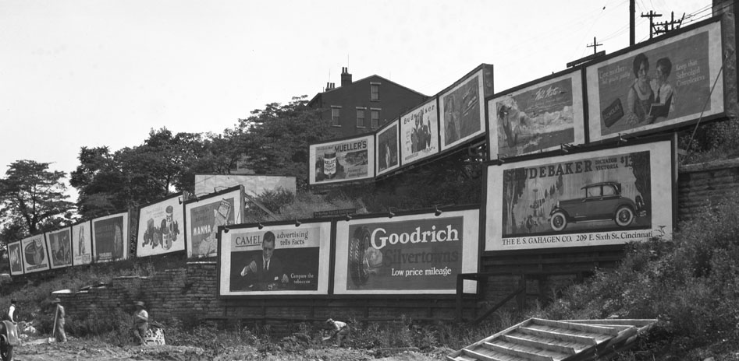
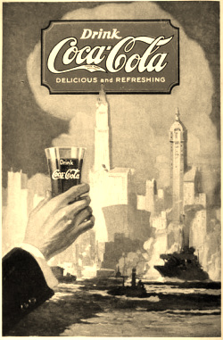

Slide 9
Jazz Age
-Flapper girls changed women’s fashion
-Radio helped increase popularity of jazz (and was the main form of entertainment)
-Prohibition & Speakeasies increased crime & gang activity

Slide 10
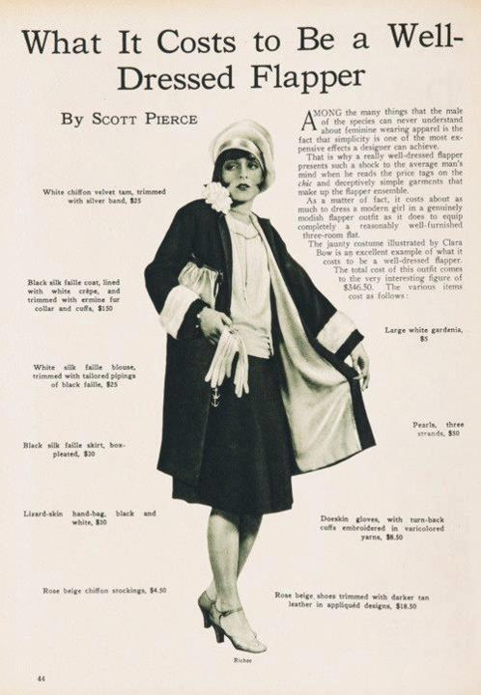
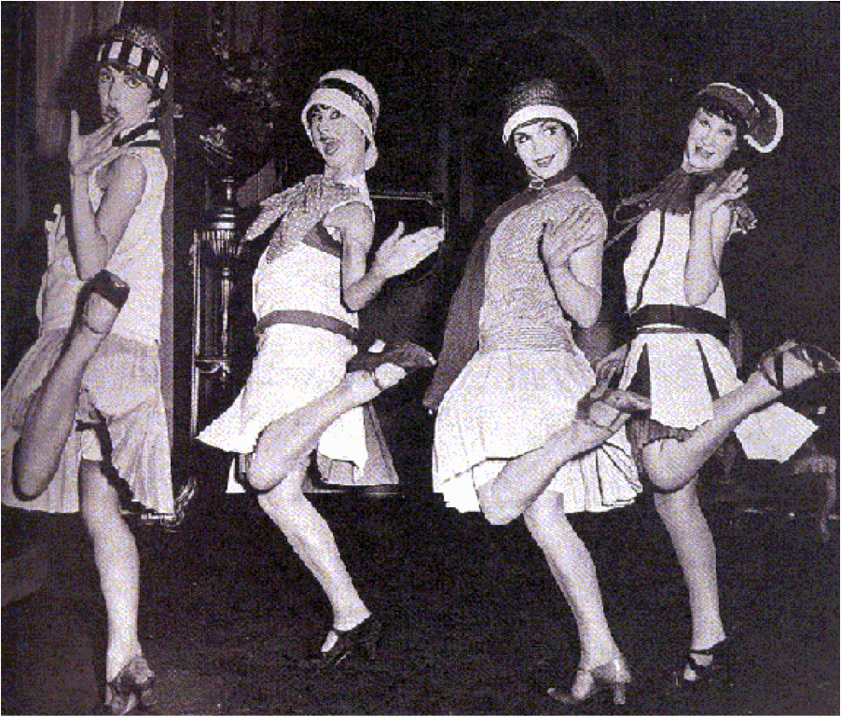
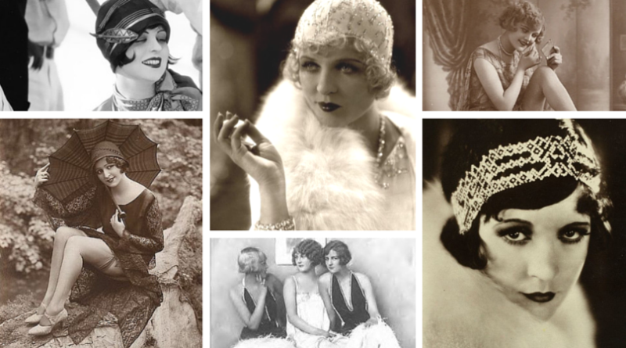
Changing Women's Fashion
Flappers wore “short” dresses/skirts (knee length)
Short hair was stylish in the 20’s

Slide 11
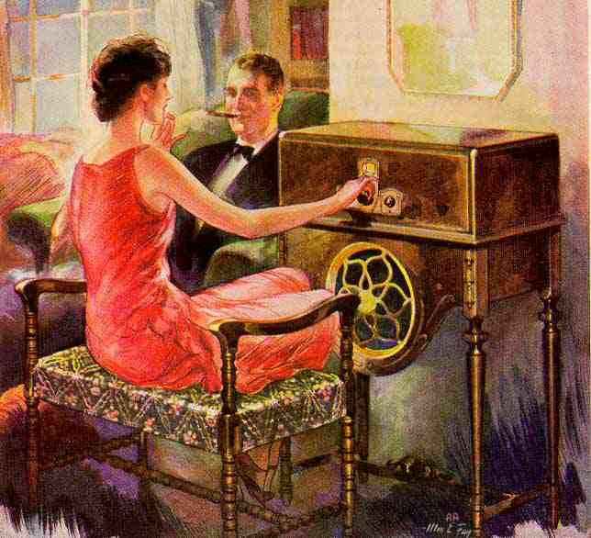
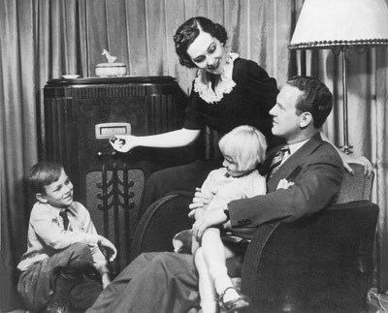
Radio
Radio was the most popular form of in-home entertainment, (it was free!)
Radios broadcast many programs:
Live theater performances
Sporting events
Concerts
Comedy shows
Music
Local radio was often subject to racial politics

Slide 12
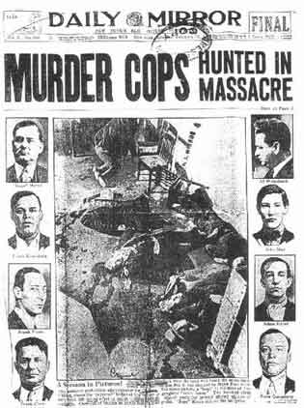
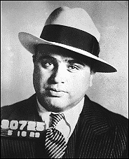
An Era of Crime & Gangsters
Prohibition (a law that banned making and selling alcohol) created an age of organized crime.
Speakeasies were underground clubs
Many gangs controlled the sale of alcohol and bribed city police men

Slide 13
Women’s Suffrage
-Women had been fighting for the right to vote since the 1850’s and finally gained the right to vote on August 26, 1920.
-During WWI they worked in factories while men were away proved that they were just as patriotic and able as men.

Slide 14
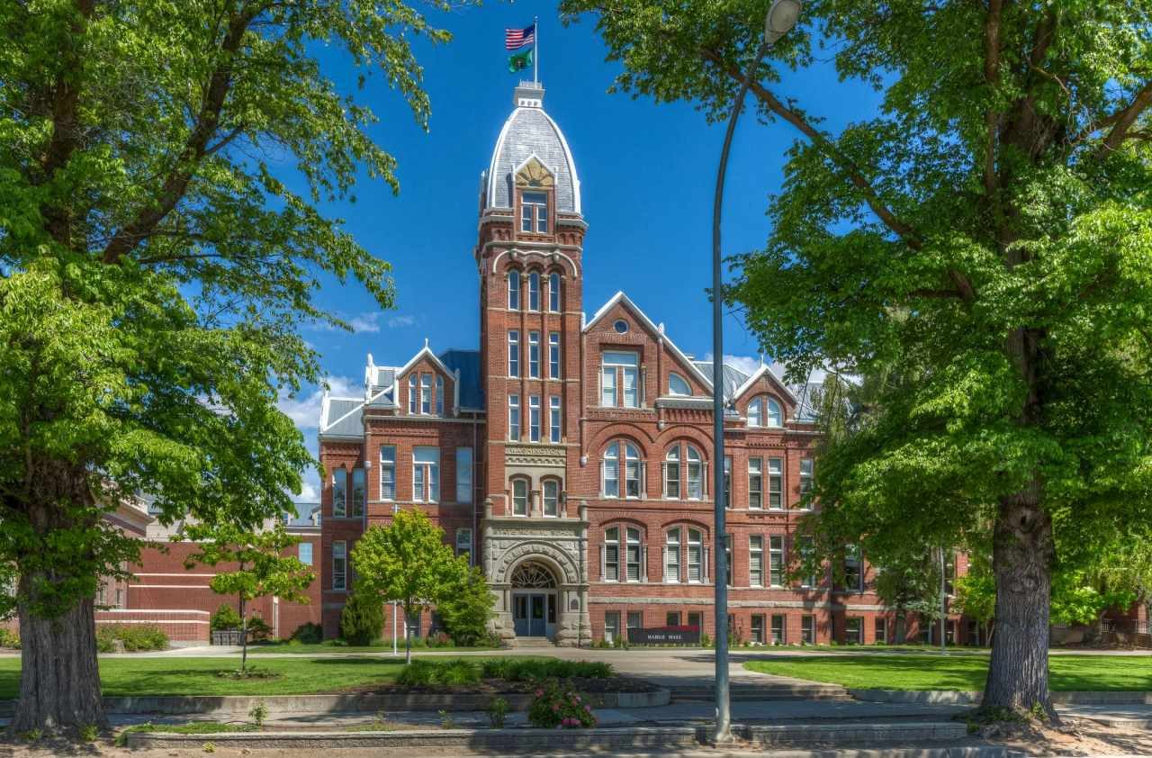
New Roles for Women
Many women chose to work after the war instead of falling back into the role as a housewife
Jobs for women were restricted and included:
Nurses
Librarians
Teachers
Secretaries

Slide 15
Harlem Renaissance
-Racism lessened slightly after the war, where blacks and whites had fought on the lines together.
-Great Migration of African Americans moved (S to N) to big cities
-Whites still dominated the poetry, art, writing, theater, and music industries, but African Americans gained public attention (not recognition) for their work

Slide 16
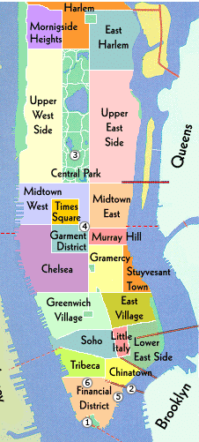
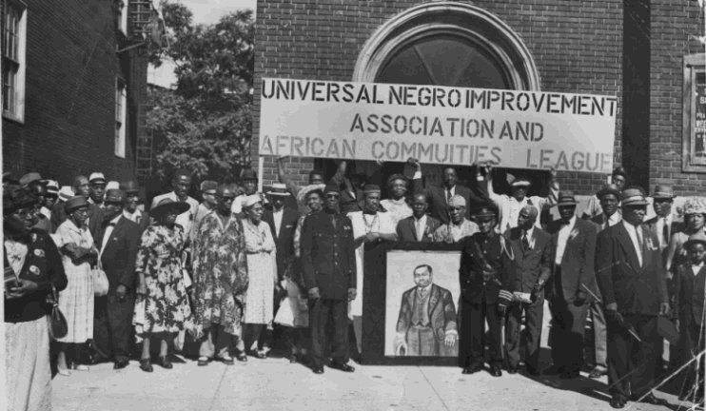
What is Harlem?
A mostly-black neighborhood in New York City
this is where the movement started

Slide 17
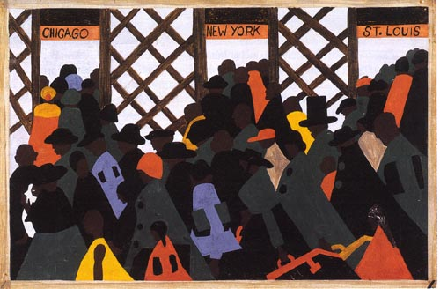
Migration of the Negro by Jacob Lawrence

Slide 18
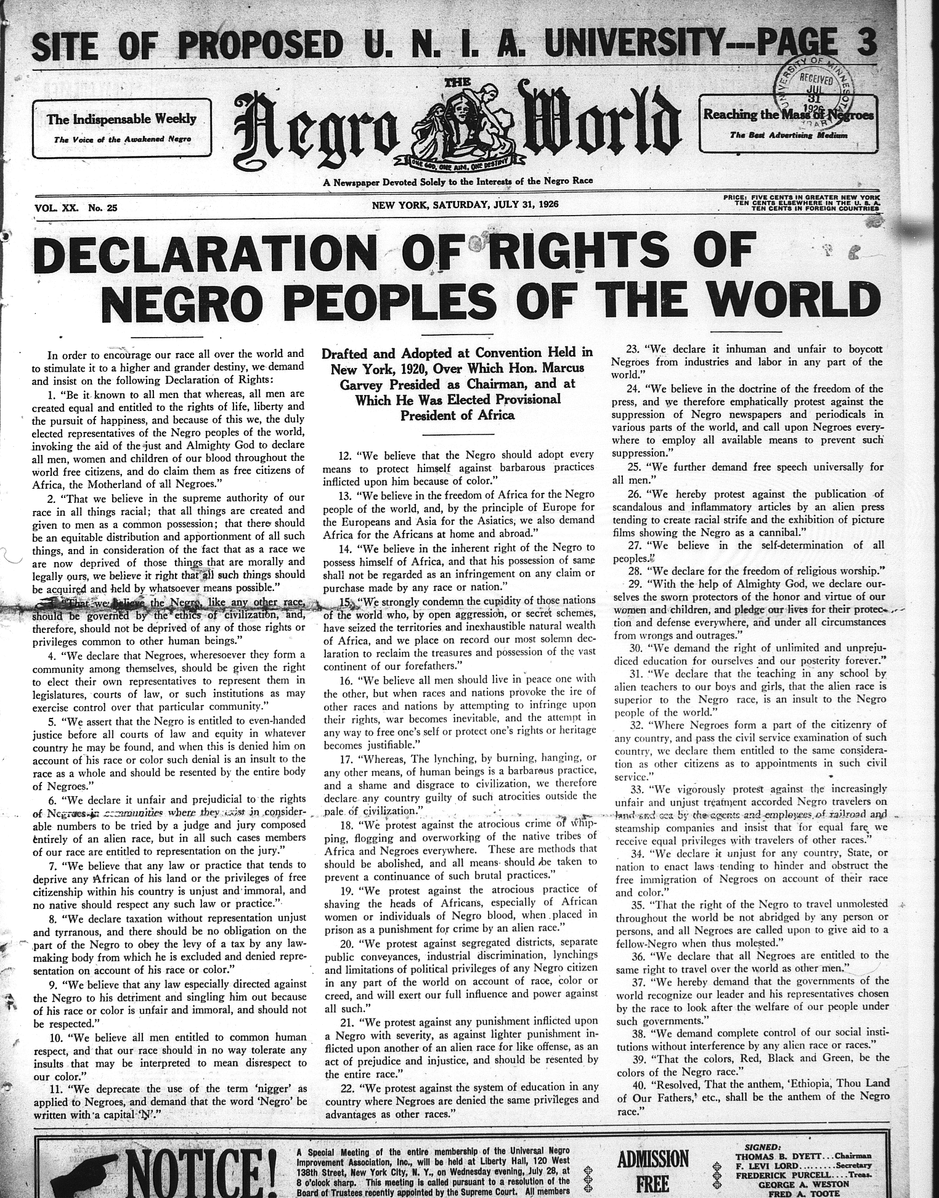
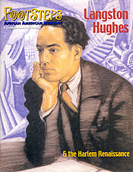
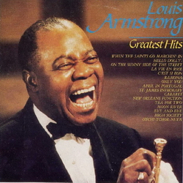
People of the Harlem Renaissance
Marcus Garvey
believed that African Americans should build a separate society in Africa & founded the Universal Negro Improvement Association (UNIA) with over 1 million members by the mid-1920s.
W.E.B. DuBois
Writer, historian, poet and activist
Langston Huges
Poet that described daily life of African Americans. Many poems were put to music
Louis Armstrong
Jazz musician

Slide 19
