Slide 1
THE SILK ROAD

Slide 2
Happy Friday!!!
Take out your composition notebook AND notes from the week
Take out a pencil
Grab a gluestick from the front table (you may need to share with a shoulder partner)
Everything else should be off your desk

Slide 3
Cut & glue your notes into your notebook in the following order.
****Each new page begins with the binding on the LEFT
Maps notes
South America Notes
Civilizations notes table (yesterday) Don’t glue this one just carefully place in notebook (we will staple these into notebooks on tuesday)
Eurasia map (it should eb blank, we are completing this today)

Slide 4
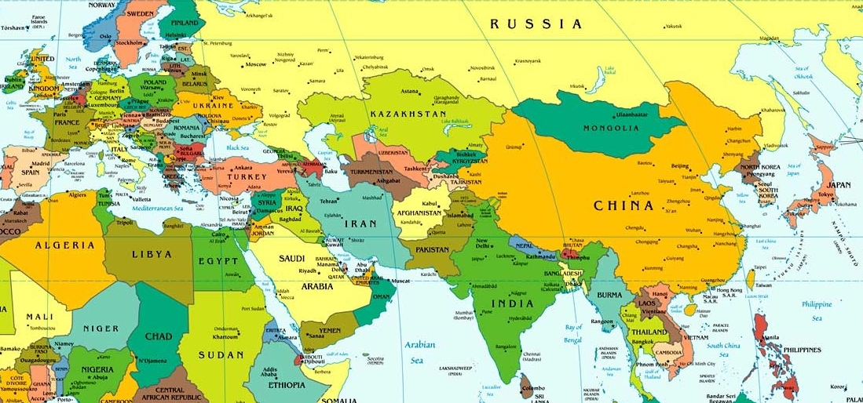
Look at your notes from yesterday & use your eurasia map to label the countries & regions that you see.

Slide 5
https://www.youtube.com/watch?v=vn3e37VWc0k
------ Draw silk road route on your eurasia maps ------
Which you watch the video answer the questions…
What is the silk road?
What goods/technologies were traded?
What religions/ideas were spread?
How did the silk road lead to the age of exploration?

