Slide 1
WWII - Introduction:
Most devastating war in human history
Atomic Bombs
U-boats
Planes
Allied Powers: England, USSR, U.S.
Axis Powers: Germany, Italy, & Japan

Slide 2
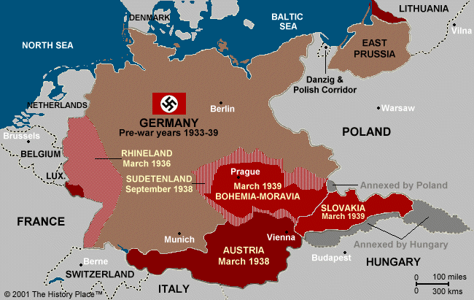

Slide 3
Germany After WWI

Slide 5
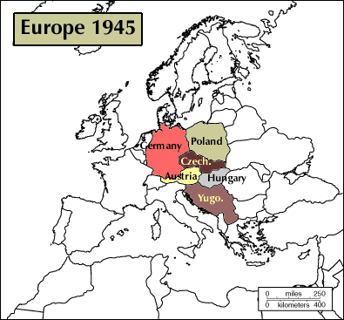

Slide 6
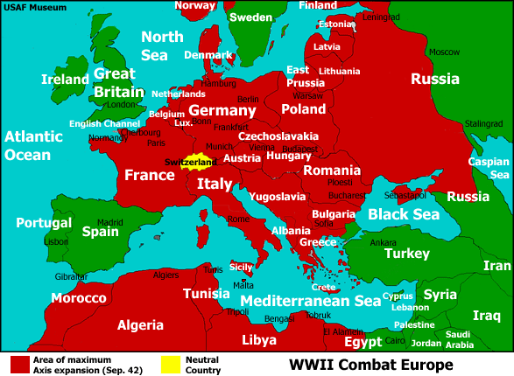
Third Reich
Nationalist
imperialism
Continental empire
Autarky
Elimination of non-Germans
Elimination of enemies

Slide 7
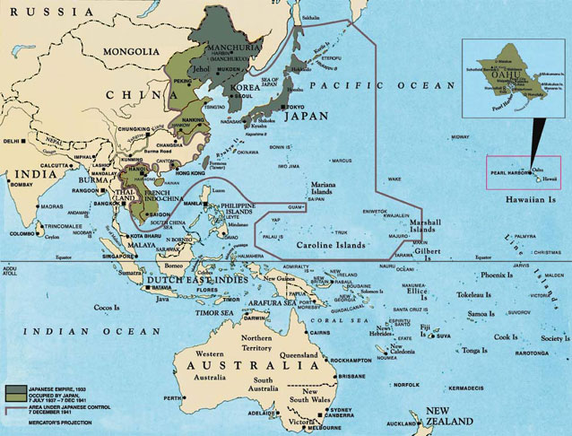
The Empire of Japan
Autarky
Security
Expanding buffer zones
Anti-imperialist imperialism
Nationalist destiny
“Asia for the Asians”

Slide 8
How It Began
WWI leftovers
Germany defeated in and had to pay cost of war. In huge economic depression
Italy victorious but wanted more territory
Japan victorious but wanted China
Outside factors…

Slide 9
What Were These Outside Factors?
Organized League of Nations (anti-war)
No action taken when Germany began invading other places
France and Britain unsure
U.S. isolationist (ignored problems)

Slide 10
(Totalitarianism) Fascism in Europe
Benito Mussolini - “Il Duce”: 1922 (Italy)
Hitler - “Fuhrer”: Chancellor of Germany
Nazi Third Reich replaces Weimar Republic.
Promise of German economic recovery.
Beginnings of the Holocaust.
German rearmament begins.

Slide 11
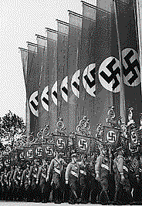
Rise of Hitler
Nazi Party organized, 1920s
Nazi party largest in Germany, 1932
Hitler voted as chancellor, 1933
New parliament created
450, 000 members
Larger than German army

Slide 13
Timeline & Map Activity

Slide 14
Label highlighted events 1-9 and write events in the boxes on timeline worksheet
2. Add non-highlighted events to timeline (these will not be in a box, just draw a line)
3. Color each event on your timeline the same color as the country that it happened in (from your map)

Slide 16
Beginning of WWII (1934-1940)
In Europe: very little actual fighting happened.
Instead Germany invaded and occupied, took control of, many countries.
These countries adopted a policy of appeasement, or giving in to Hitler’s demands in order to keep world peace.
In Japan:
Japanese had been at war with China since they had occupied Manchuria in 1931
Fighting began between China and Japan in 1937

Slide 17
Warning Signs
Europe/Africa:
Italy invades & conquers Ethiopia (North Africa)
Germany builds up military
Germany conquered lands around it to get “living space” for Germans
- When Germany conquered Austria and Czechoslovakia Britain & France told the Czech’s to cooperate.
- At the Munich Conference (1938) Hitler promised he would not take any more territory

Slide 18
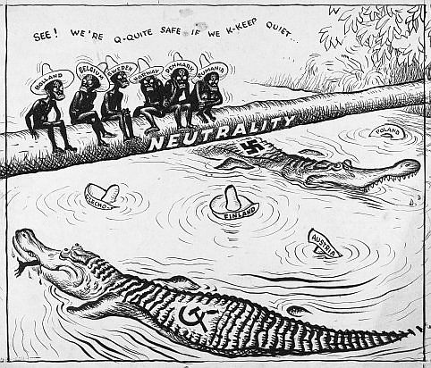

Slide 19
United States Stayed “Neutral”
United states banned Japanese Immigration in 1924 because of growing Militarism
United States wanted to stay out of any war.
Passed the Neutrality Acts which outlawed trading or giving financial support to any nation at war.

Slide 20
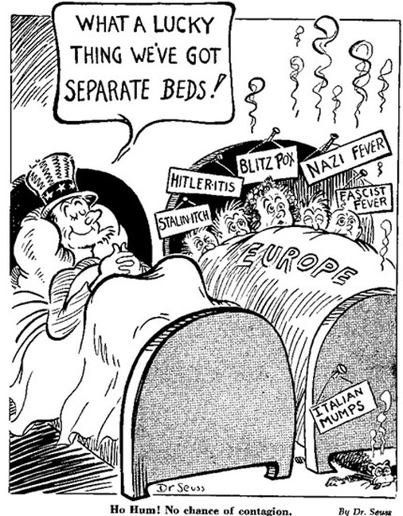

Slide 21
Europe Heads Toward War in 1939
March 1939 Hitler invades the rest of Czechoslovakia (breaks promise with Britain to not take any more land)
August 1939 USSR & Germany sign the Nazi-Soviet Pact.
Neither country would go to war with the other
If Germany or USSR went to war and conquered eastern Europe the two countries would divide the territory.

Slide 22
Battle of Britain (1940-1941)
Before the Battle, Axis Powers had conquered most of Western Europe
All combat was in the air
German air forces targeted British Air Force Bases, Military posts, and some cities
British winning this battle most likely saved them from a land invasion

Slide 23
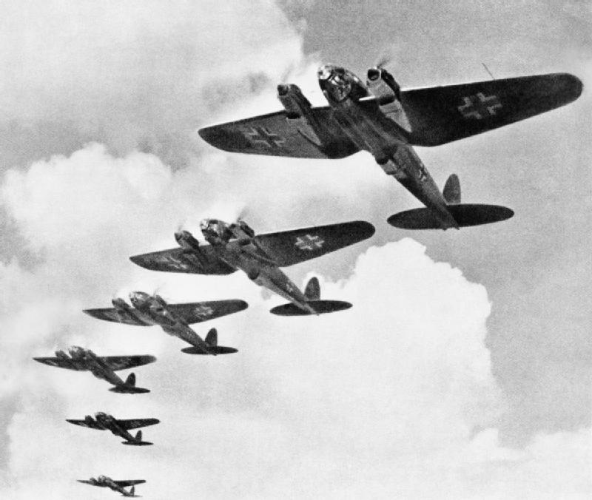
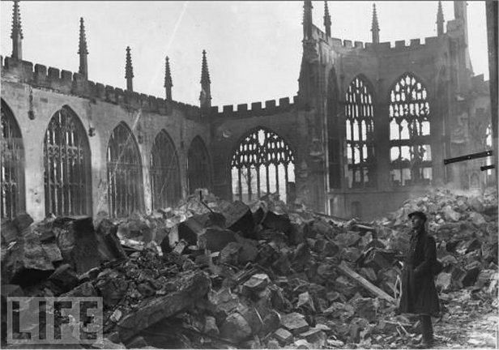

Slide 25
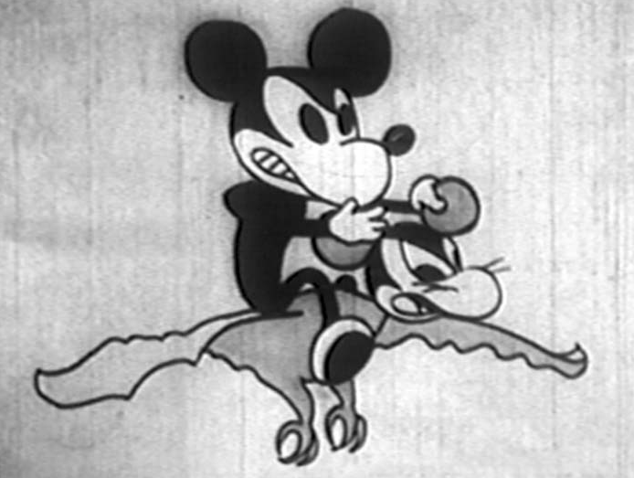
Japanese Propaganda Cartoon
What are the animals doing before they hear Mickey? What is their reaction after they hear him?
Who/where do Japanese animals get to help fighting against Mickey?
Who is in Mickey’s Army? (3 animals)

Slide 26
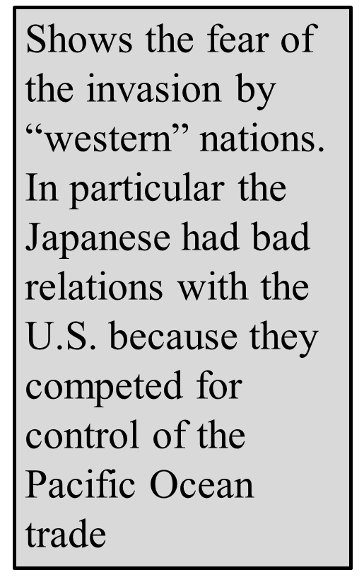
What are the animals doing before they hear Mickey? What is their reaction after they hear him?
Dancing
Animals are scared and start to shake in fear
Who/where do Japanese animals get to help fighting against Mickey?
Heroes from Japanese story books
Who is in Mickey’s Army? (3 animals)
Birds
Snakes
Alligators
This is shown to emphasize Japan’s strength as a nation (Japan can fight its own wars without help)
Explains the type of “island hopping” warfare in Pacific Theater of WWII:
Birds= Planes
Snakes= Land Invasions
Alligators= Boats

Slide 27
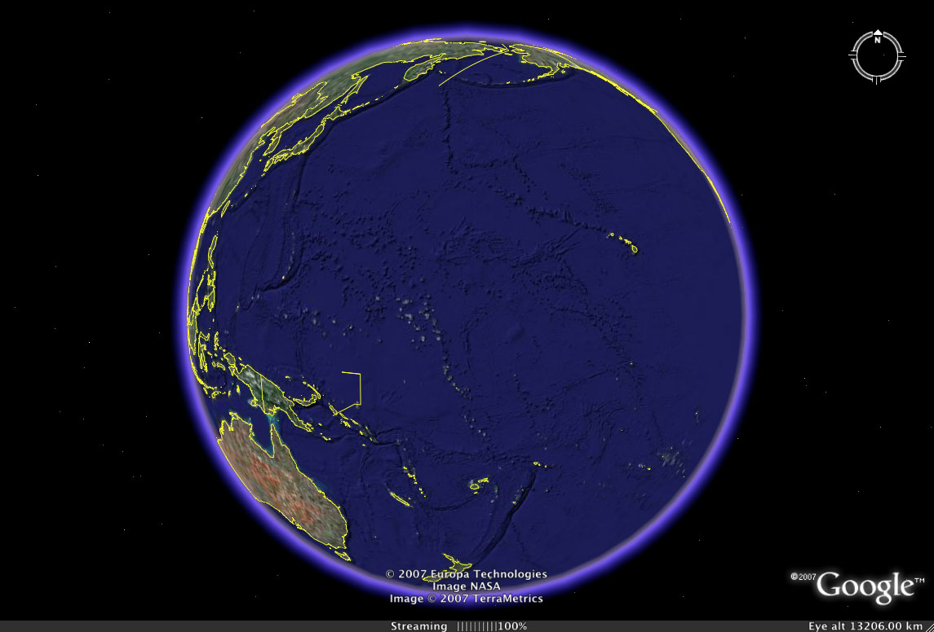
China
Japan
United States
The Pacific Ocean
SE Asia
Australia

Slide 28
World War II In the Pacific Timeline
July 1941: Embargo of Japanese Resources
Dec 7, 1941: Japanese Attack U.S. at Pearl Harbor
Aug 6, 1945: U.S. Bombs Japan at Hiroshima
Aug, 9 1945: U.S. Bombs Japan at Nagasaki
Sept 1945: Japanese Surrender

Slide 29
JAPAN
PEOPLE OF S.E. ASIAN ISLANDS
UNITED STATES

Slide 30
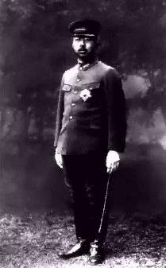
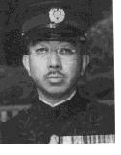
Hirohito
Emperor (& Military Leader) of Japan during WWII

Slide 31
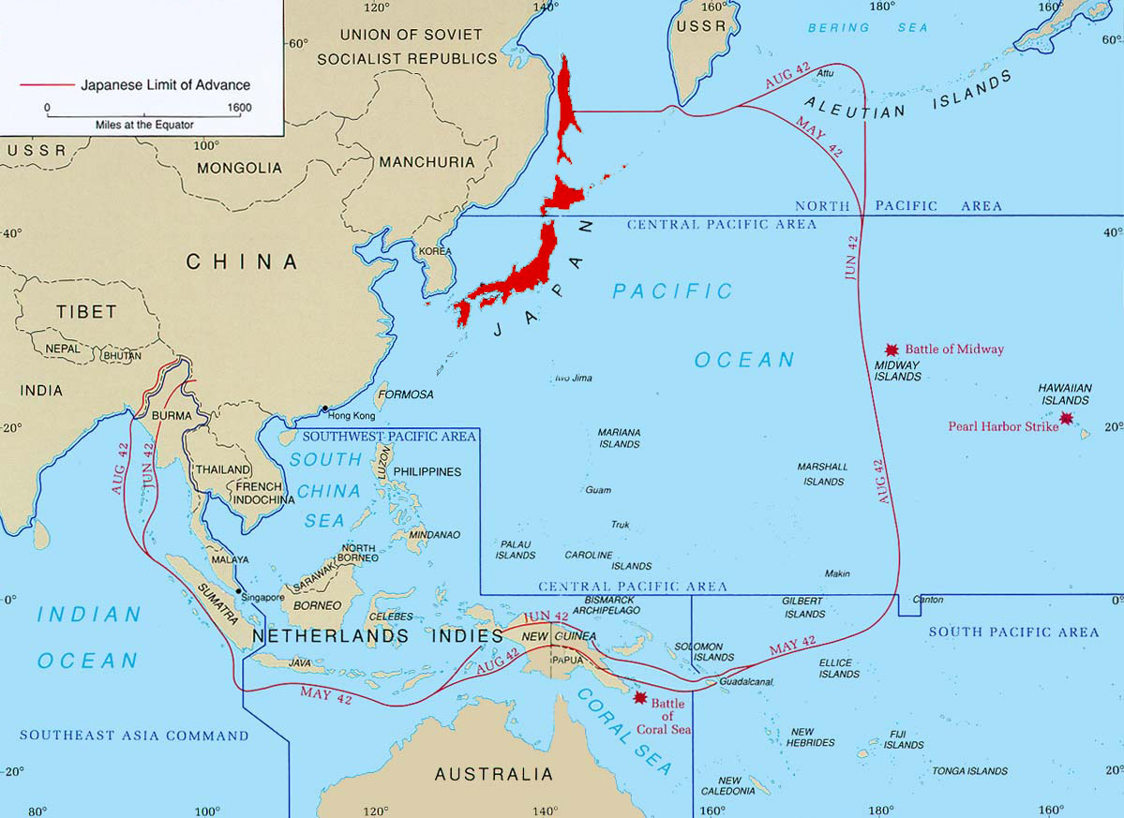
Pre-war

Slide 32
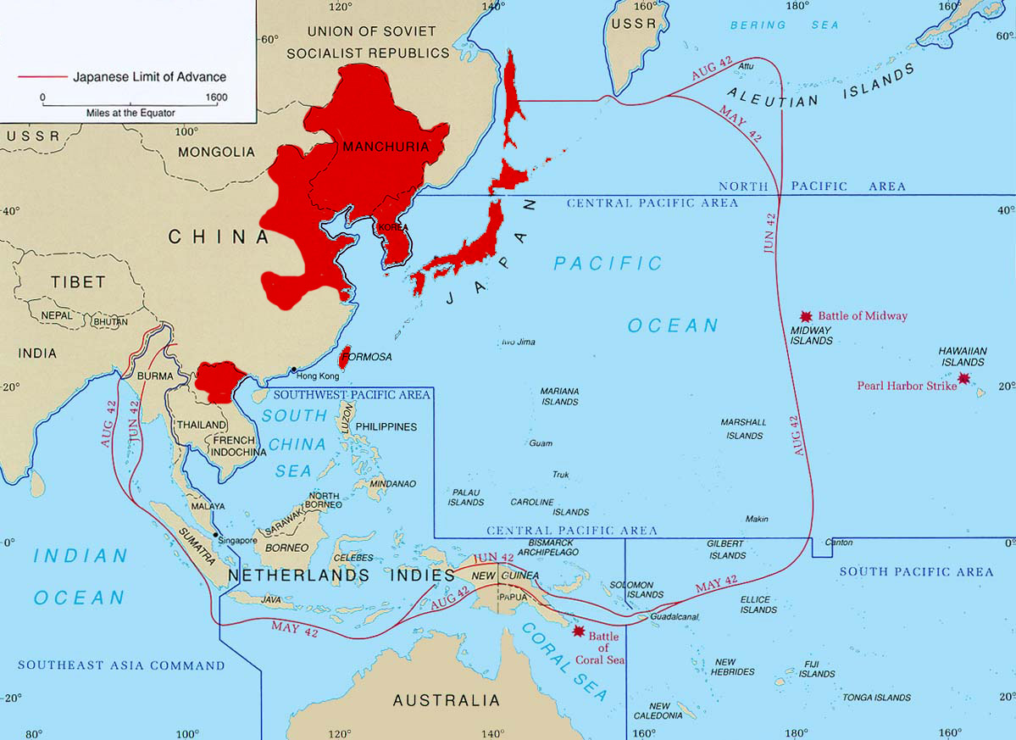
1940

Slide 33
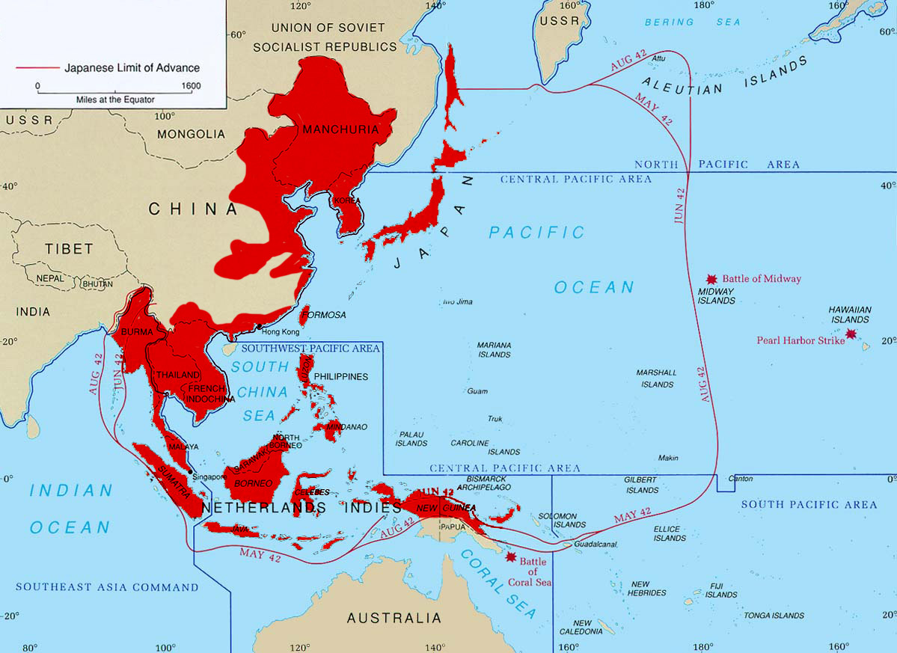
1942

Slide 34
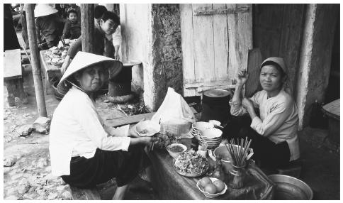
Areas Under Japanese Control
Over 20 areas/peoples….
Parts of mainland China
Vietnam
Cambodia
Laos
Thailand
Malaysia
Philippines
Indonesia

Slide 35
Challenges of War in the Pacific
Distance:
Allied forces sometimes had to travel across the ocean
Challenging Environment:
Disease took almost as many lives as combat
Beach invasions were hard because soldiers were exposed
Thick, dense jungle was a foreign environment to U.S. soldiers
Unclear Strategy
Island Hopping

Slide 36
Lola’s WWII Interview Video
https://www.youtube.com/watch?v=Lm2HSWRYVVQ

